Slide 1
Student‘s canteens
Damian Wałoszek

Slide 2
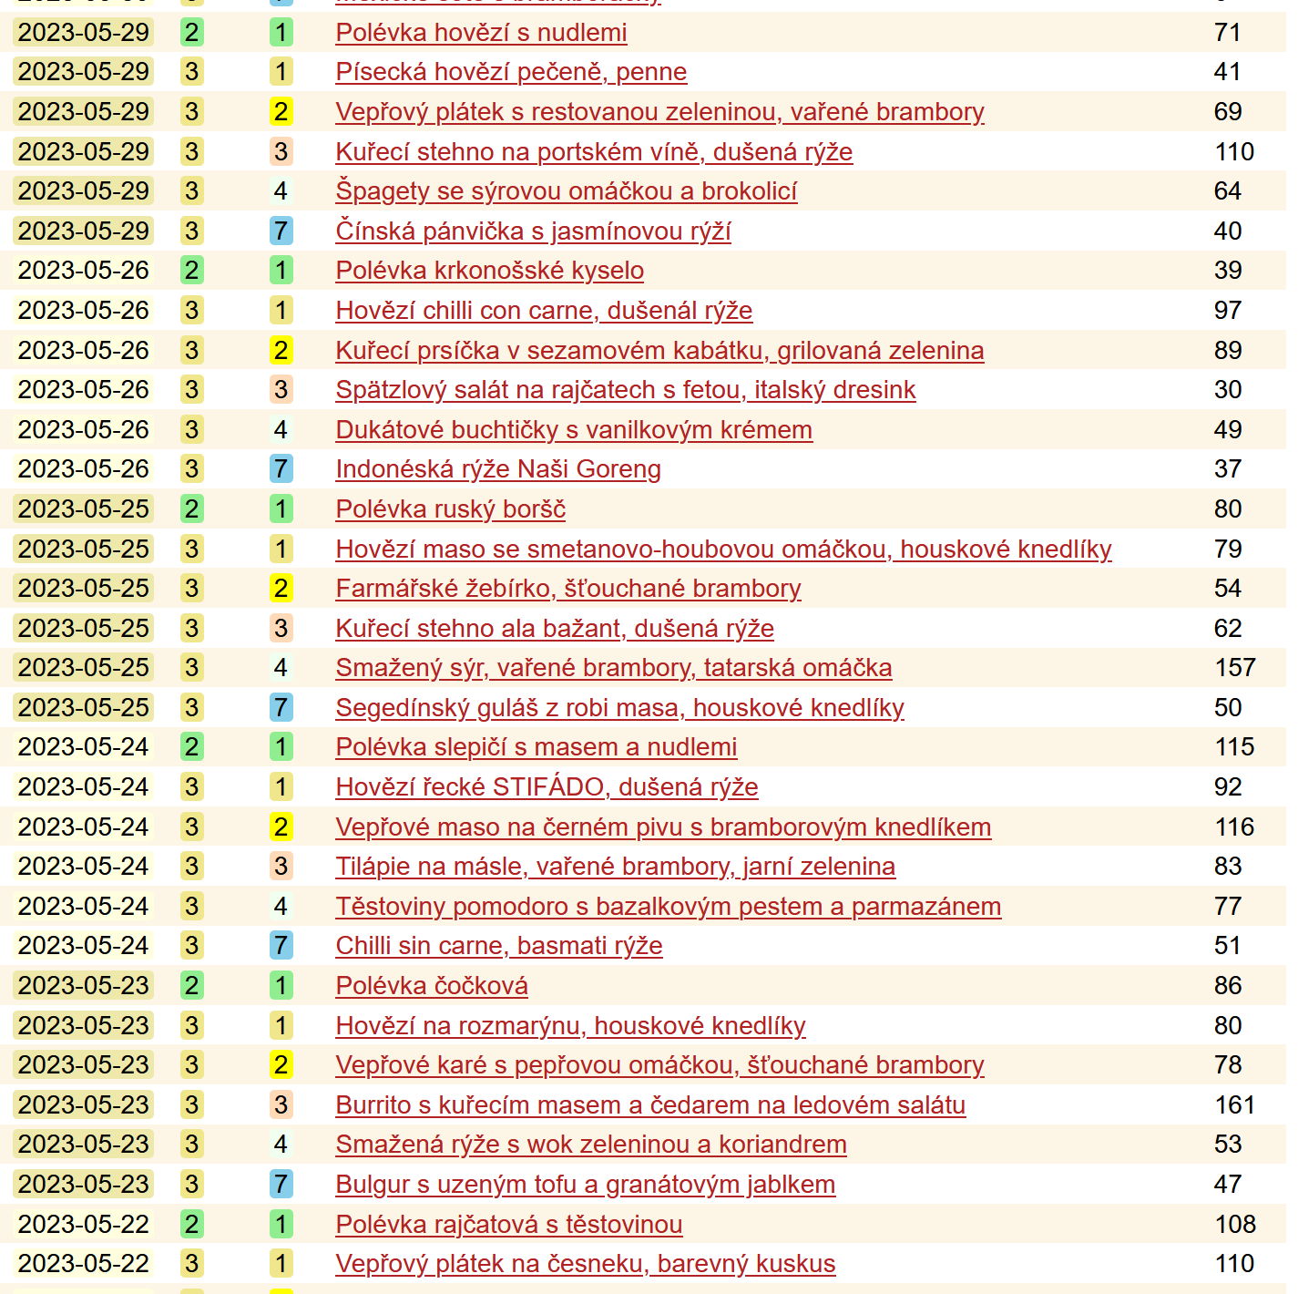
Introduction
Data on student canteens is interesting
Existing dataset https://menzostat.ggu.cz

Slide 3
Data acquisition
Menzostat queries every canteen‘s state every minute
Dataset somehow downloadable from website
Only max. 7 day interval
Bash script provided by Menzostat‘s author

Slide 4
Data preparation
A loooot of cleaning and transformation
Divide by canteen and date
Sort by time
Filter by opening hours and by date (October 2022+)
Deduplicate records with the same minute
Look after „served“ attribute that drops in time
Probably undos
Interpolate for missing records
Pick only biggest 7 canteens
Except Albertov which was closed during the year
Add records for dates that appear in some canteens
Don‘t care about preordered meals – their serving isn‘t recorded in data

Slide 5
Meals served during the year, grouped by day of the week

Slide 6
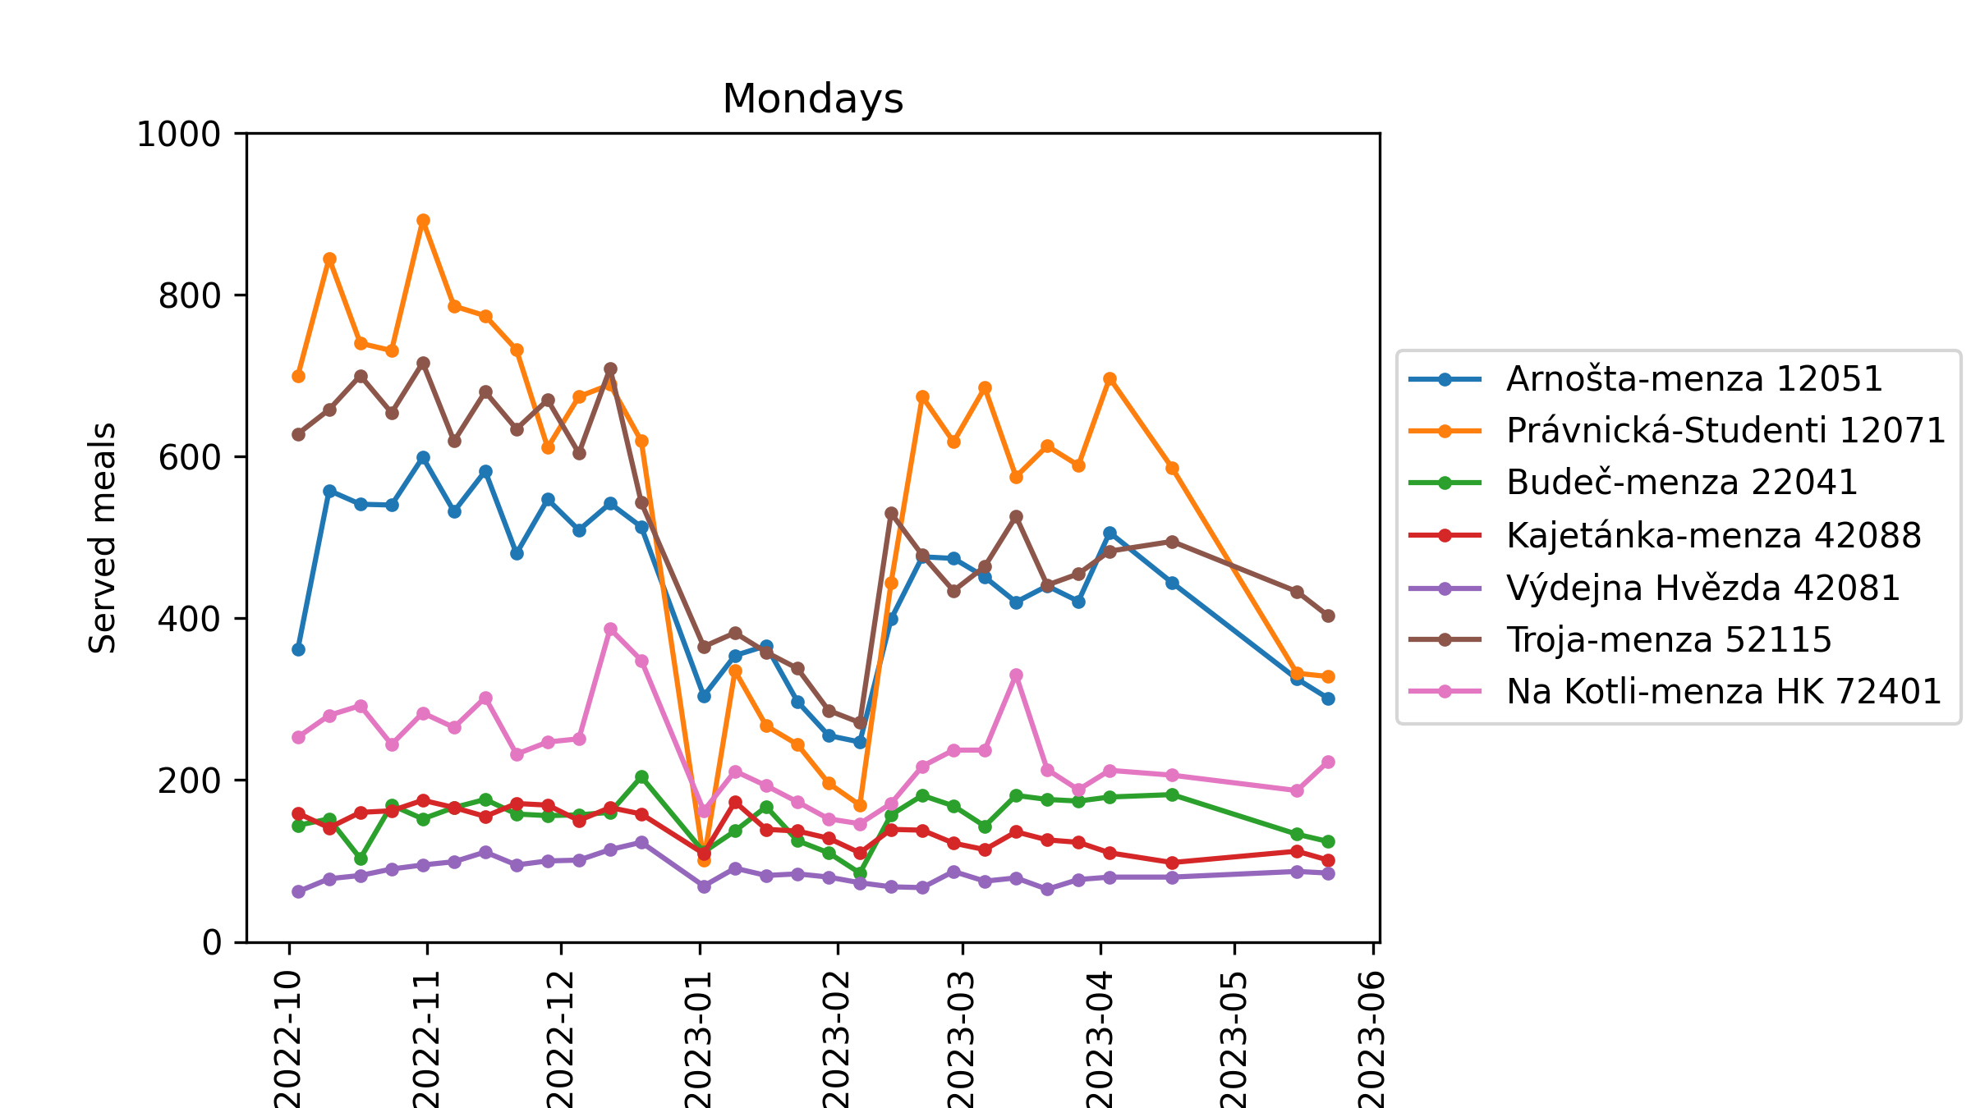
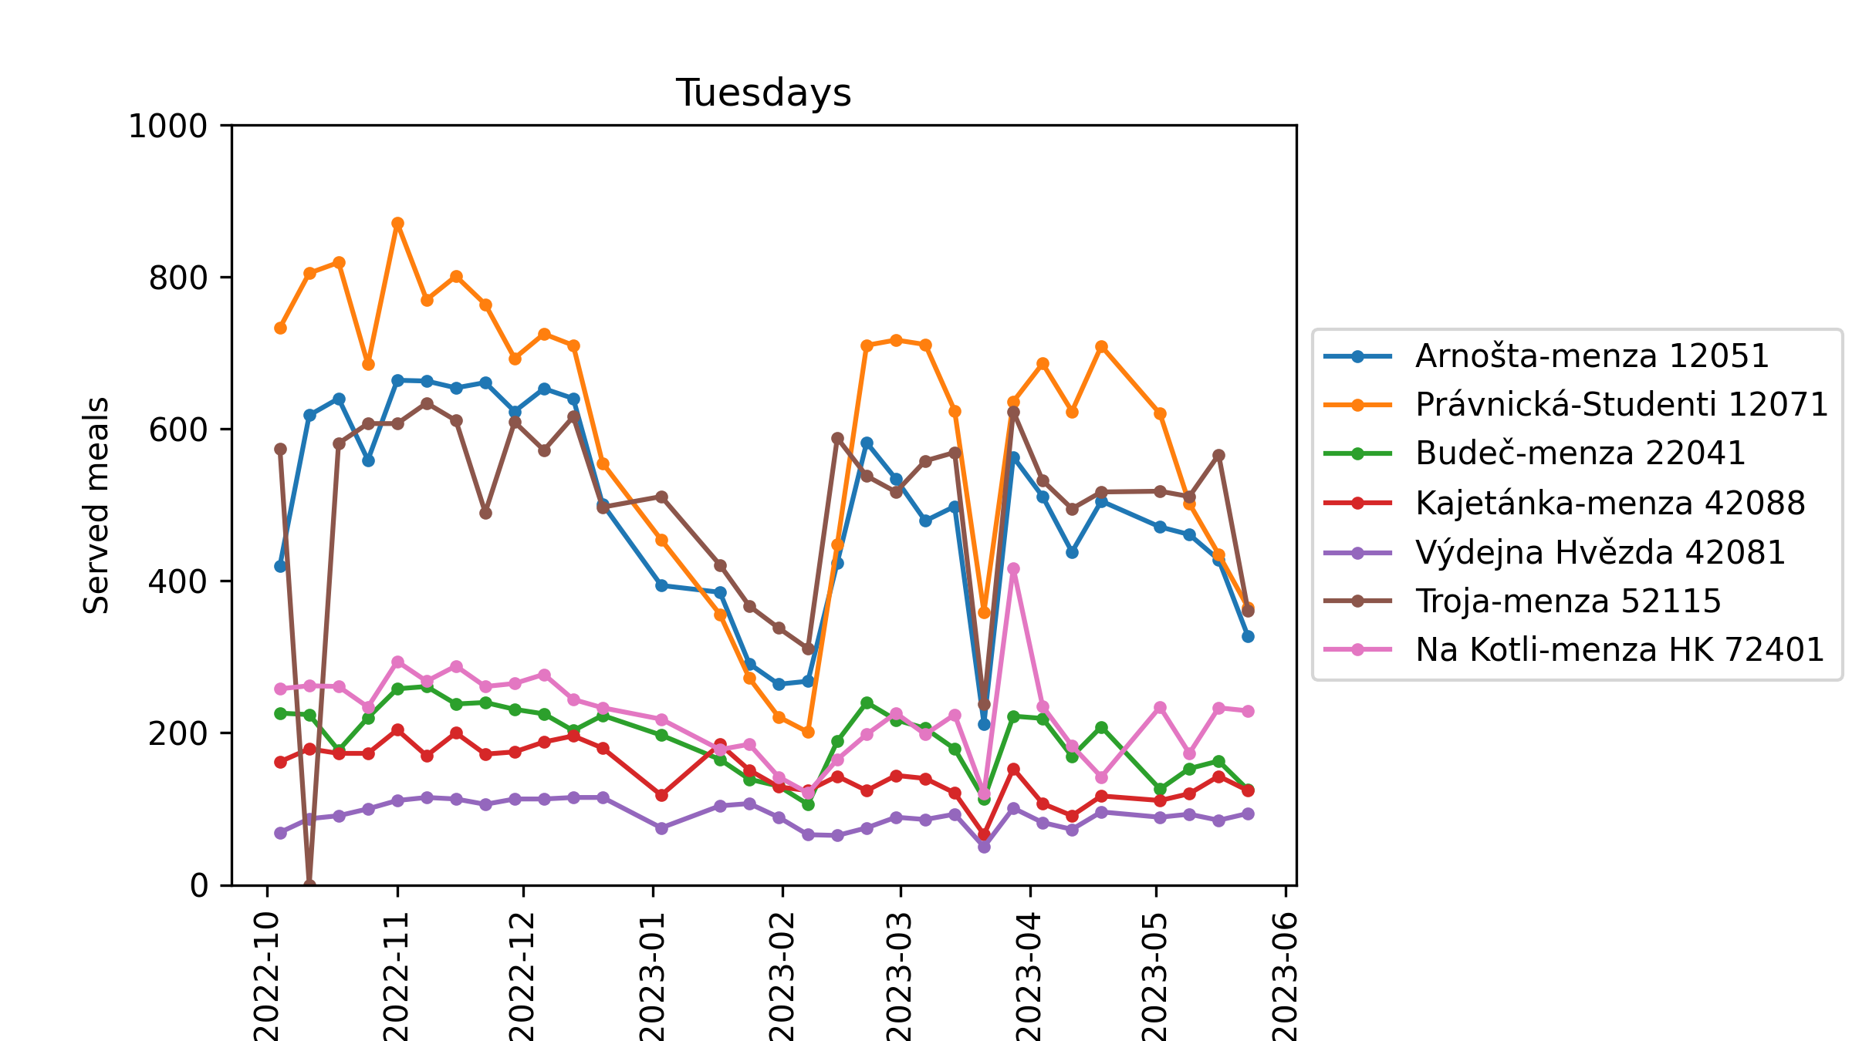
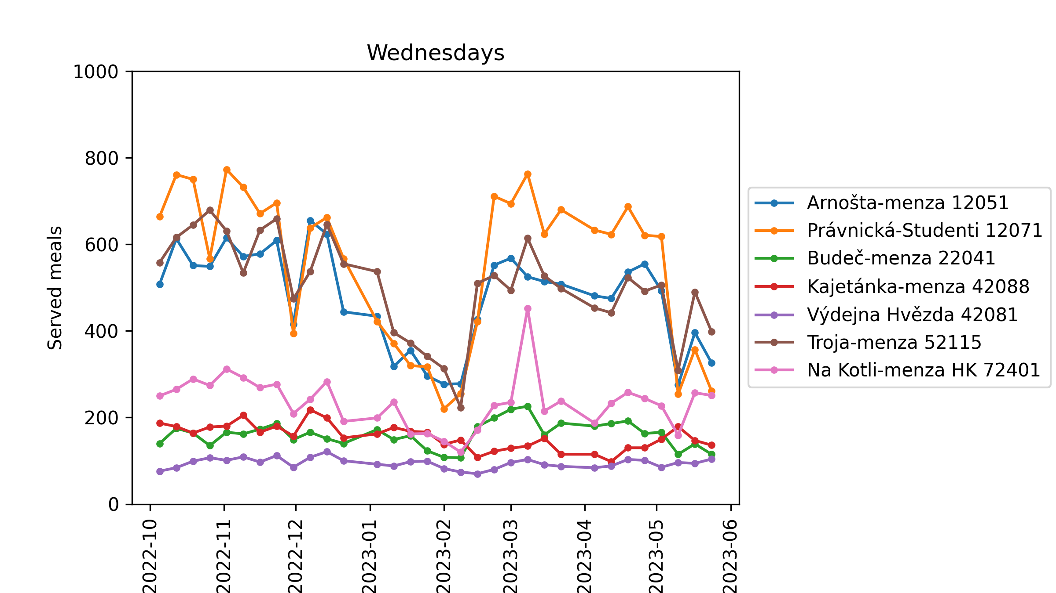
Notes:
Monday 2.1. – no lectures
Tuesday 10th month Troja – planned elektricity outage
Tuesday 21.3. – since cca. 12:00 outage of the system (or of the bot collecting the data)
Wednesday 30.11. – since cca. 13:00 outage of the system (or of the bot collecting the data)

Slide 7
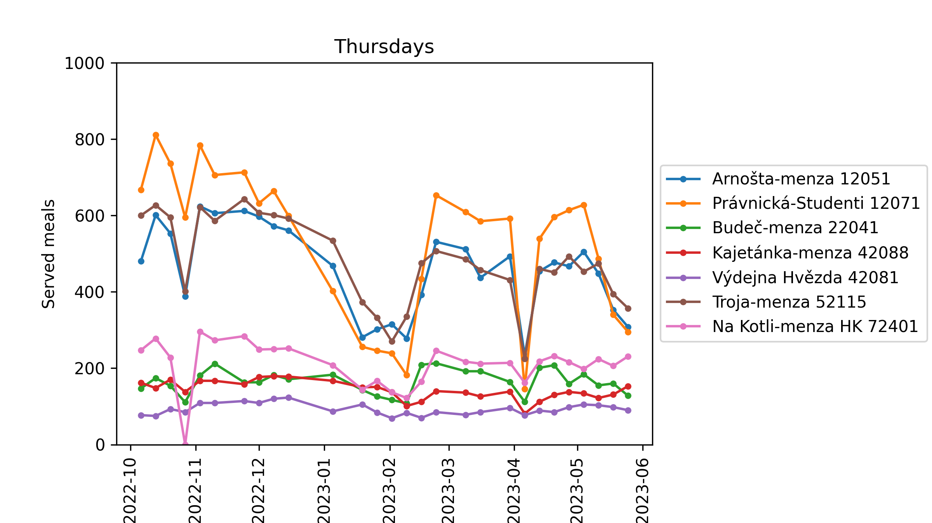
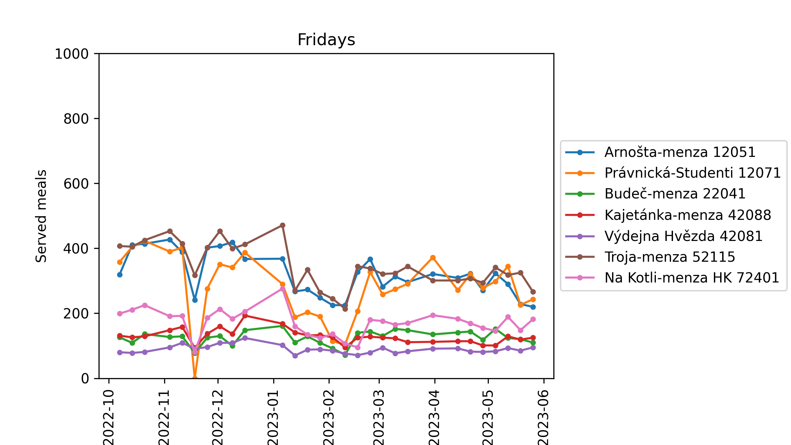
Notes:
Friday 18.11. – the day after national holiday 17.11.

Slide 8
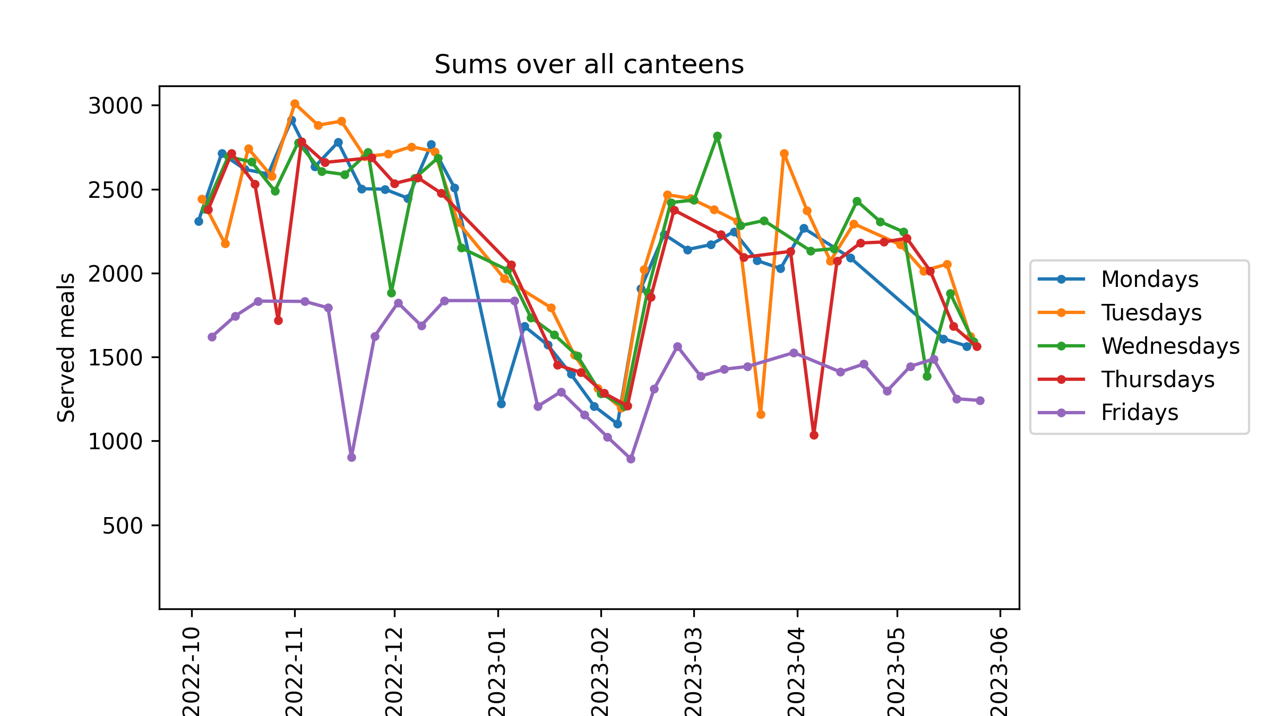
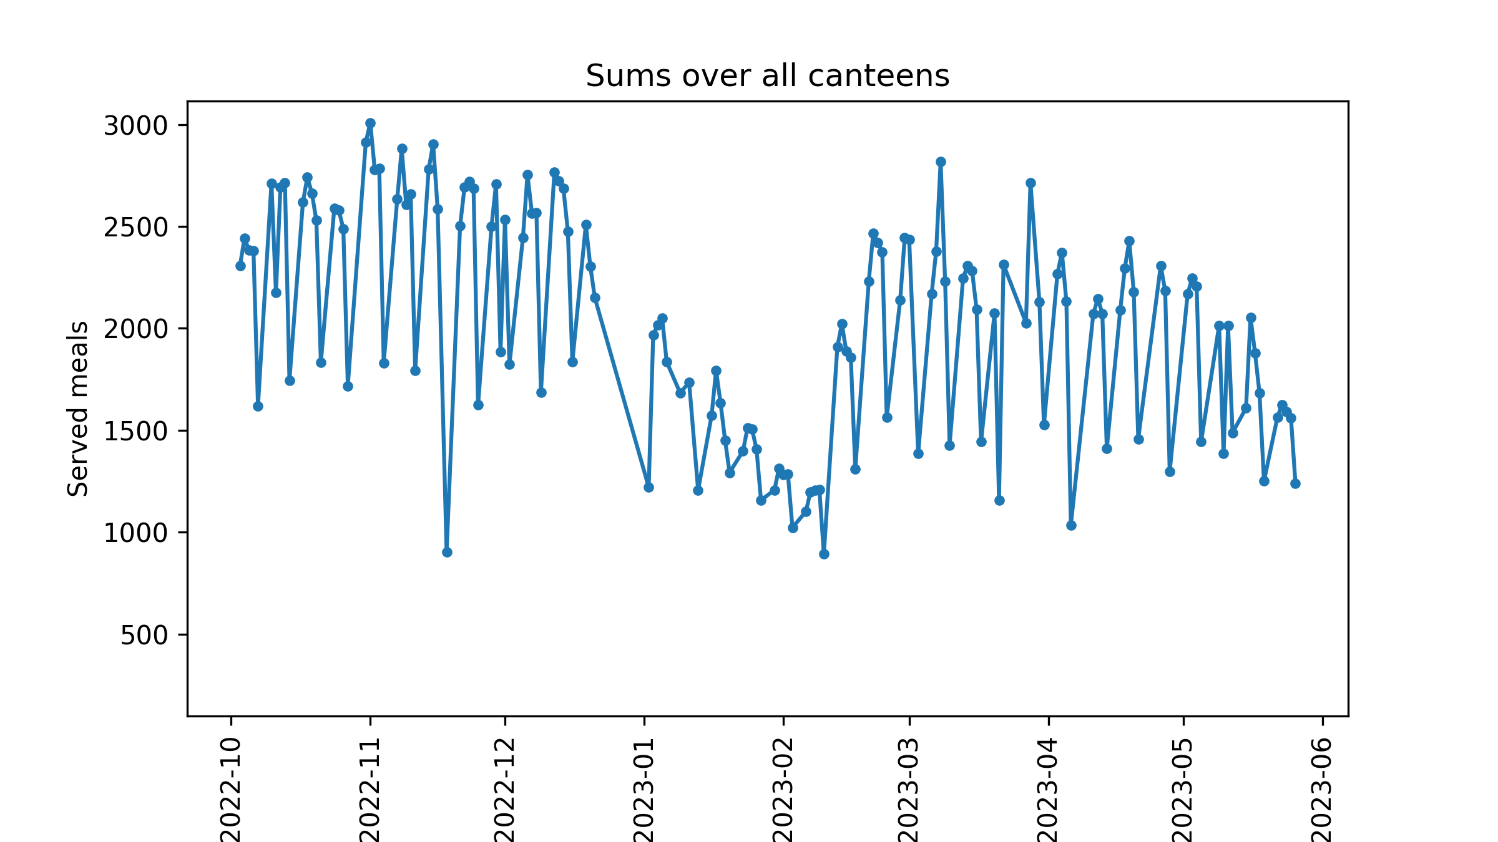

Slide 9
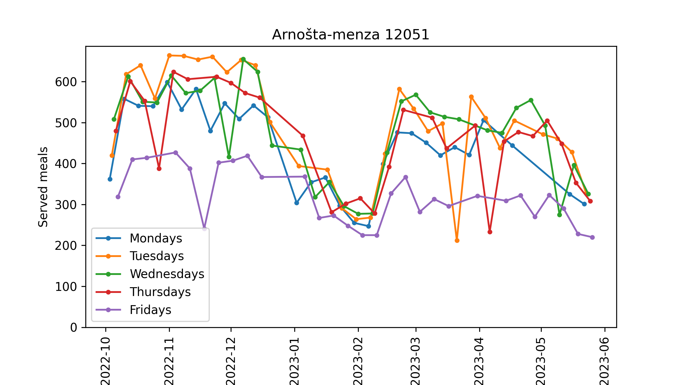
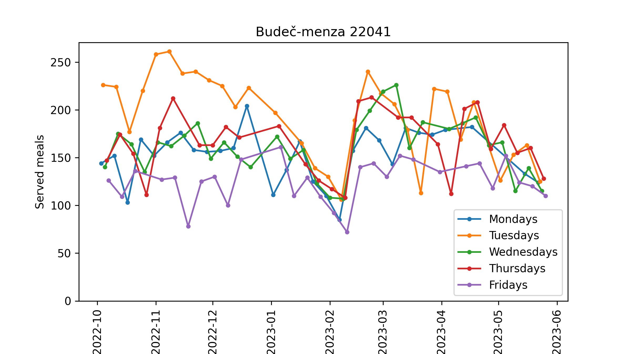
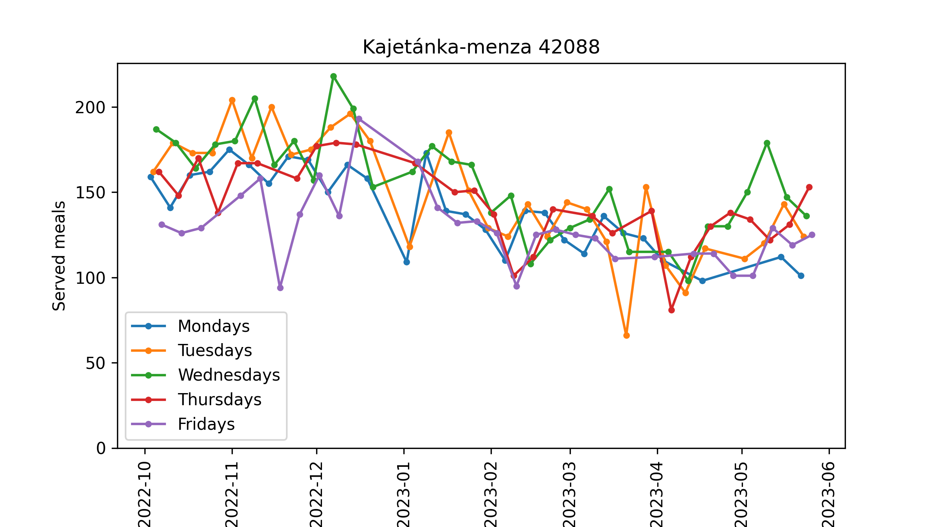
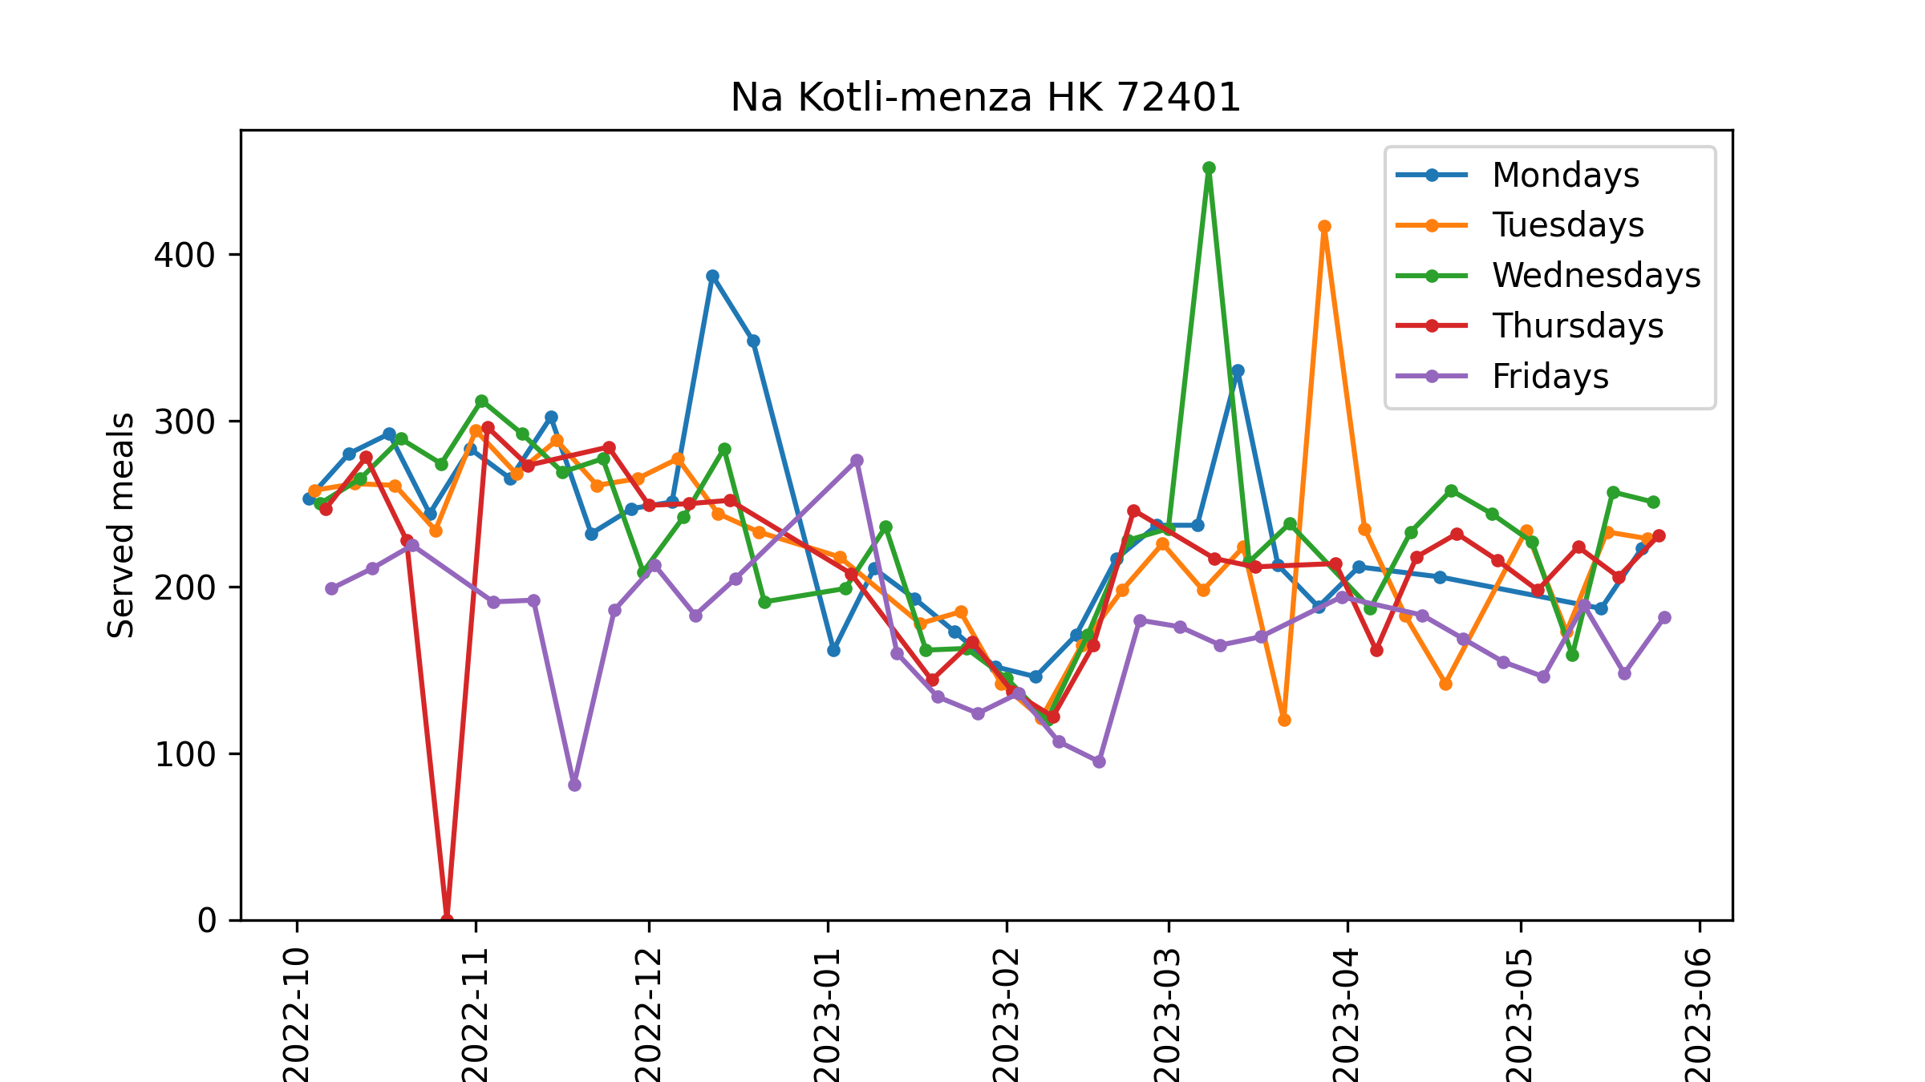

Slide 10
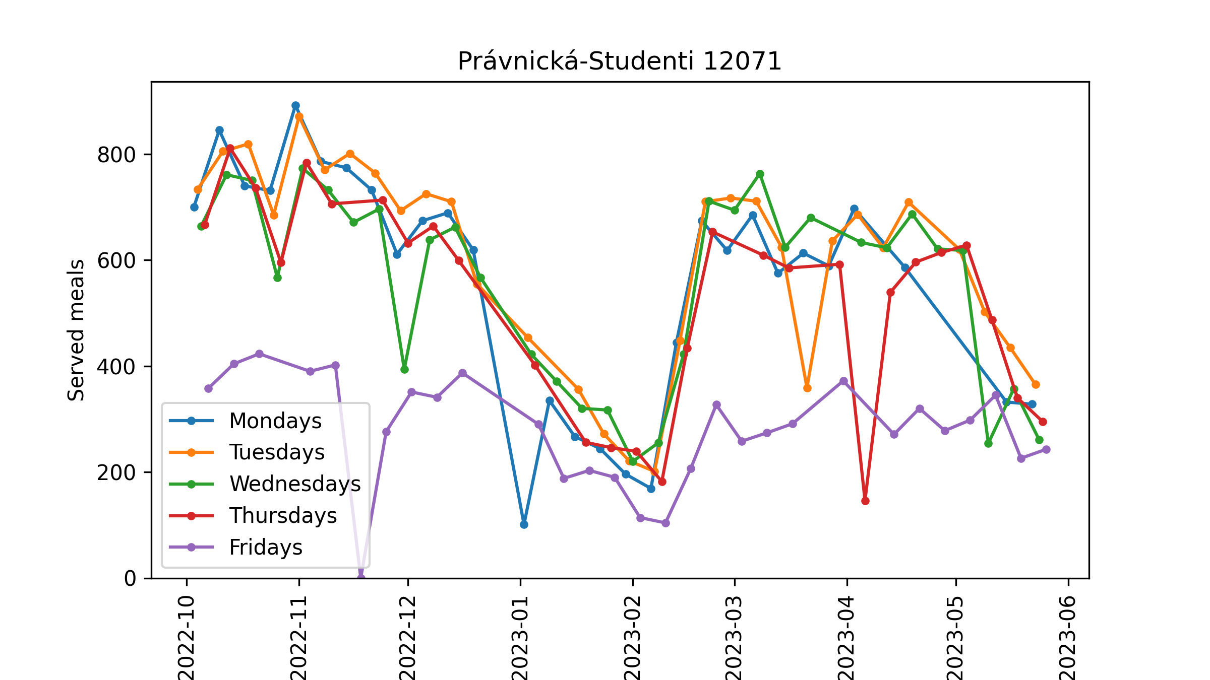
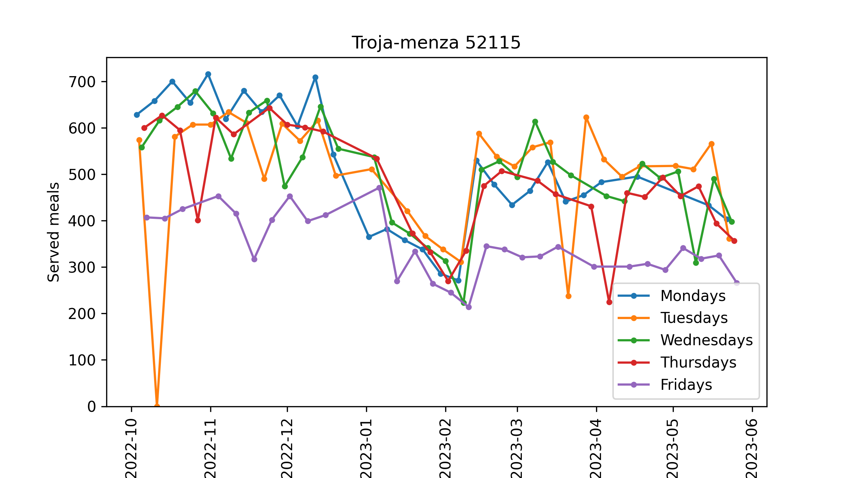
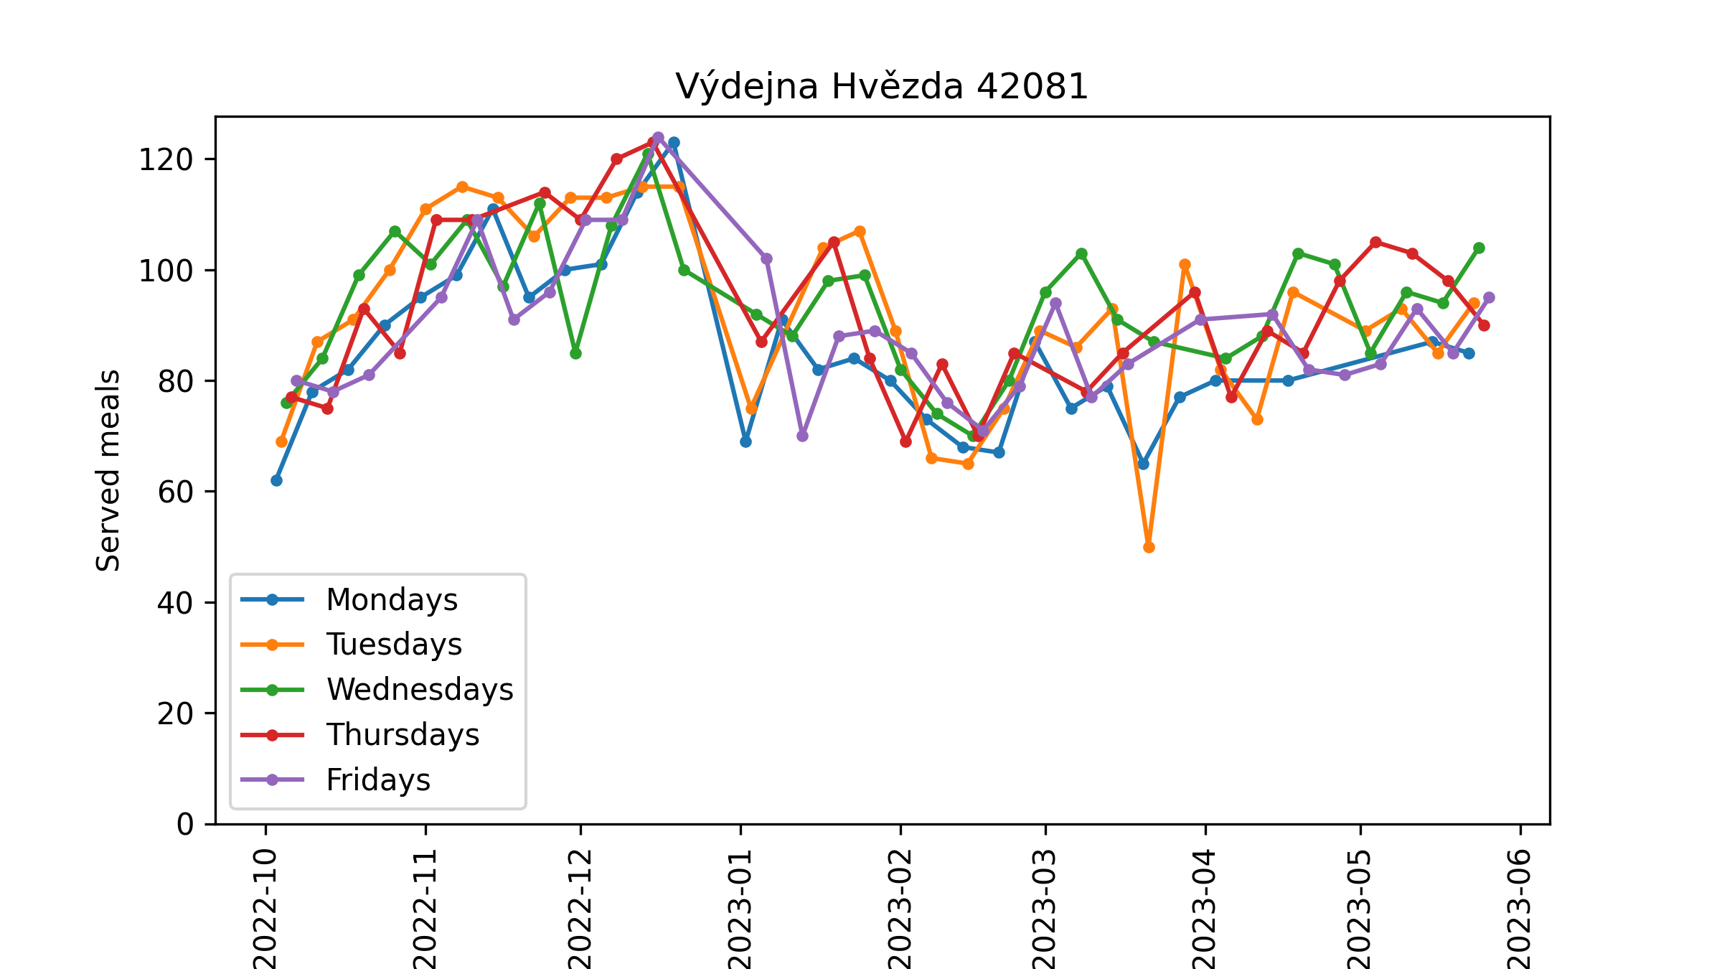

Slide 11
Meals served by interval

Slide 12
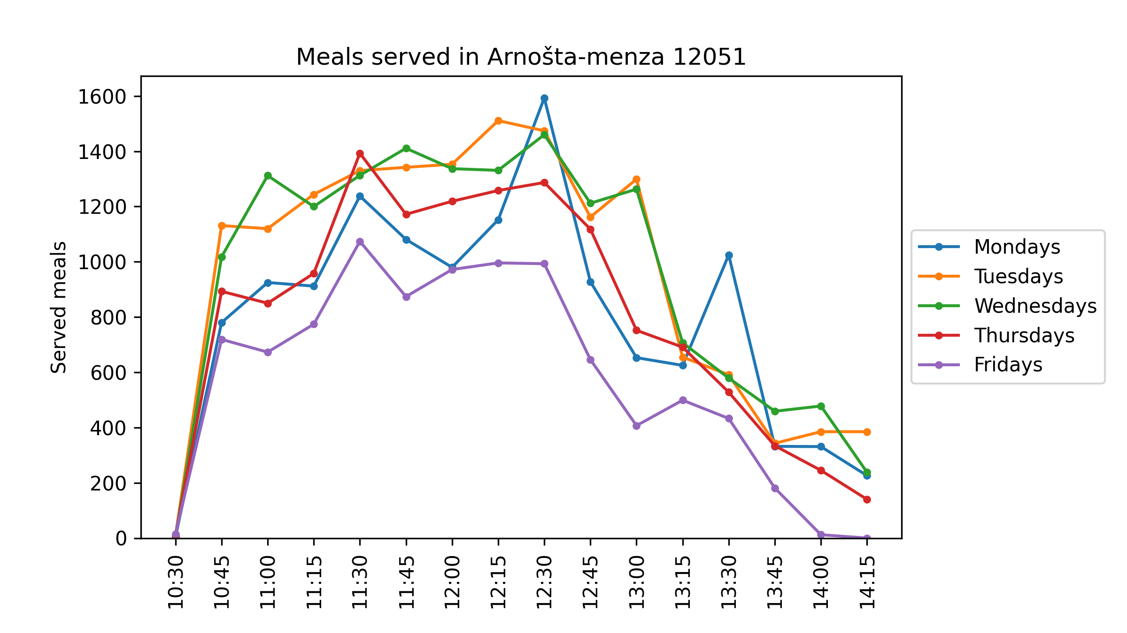
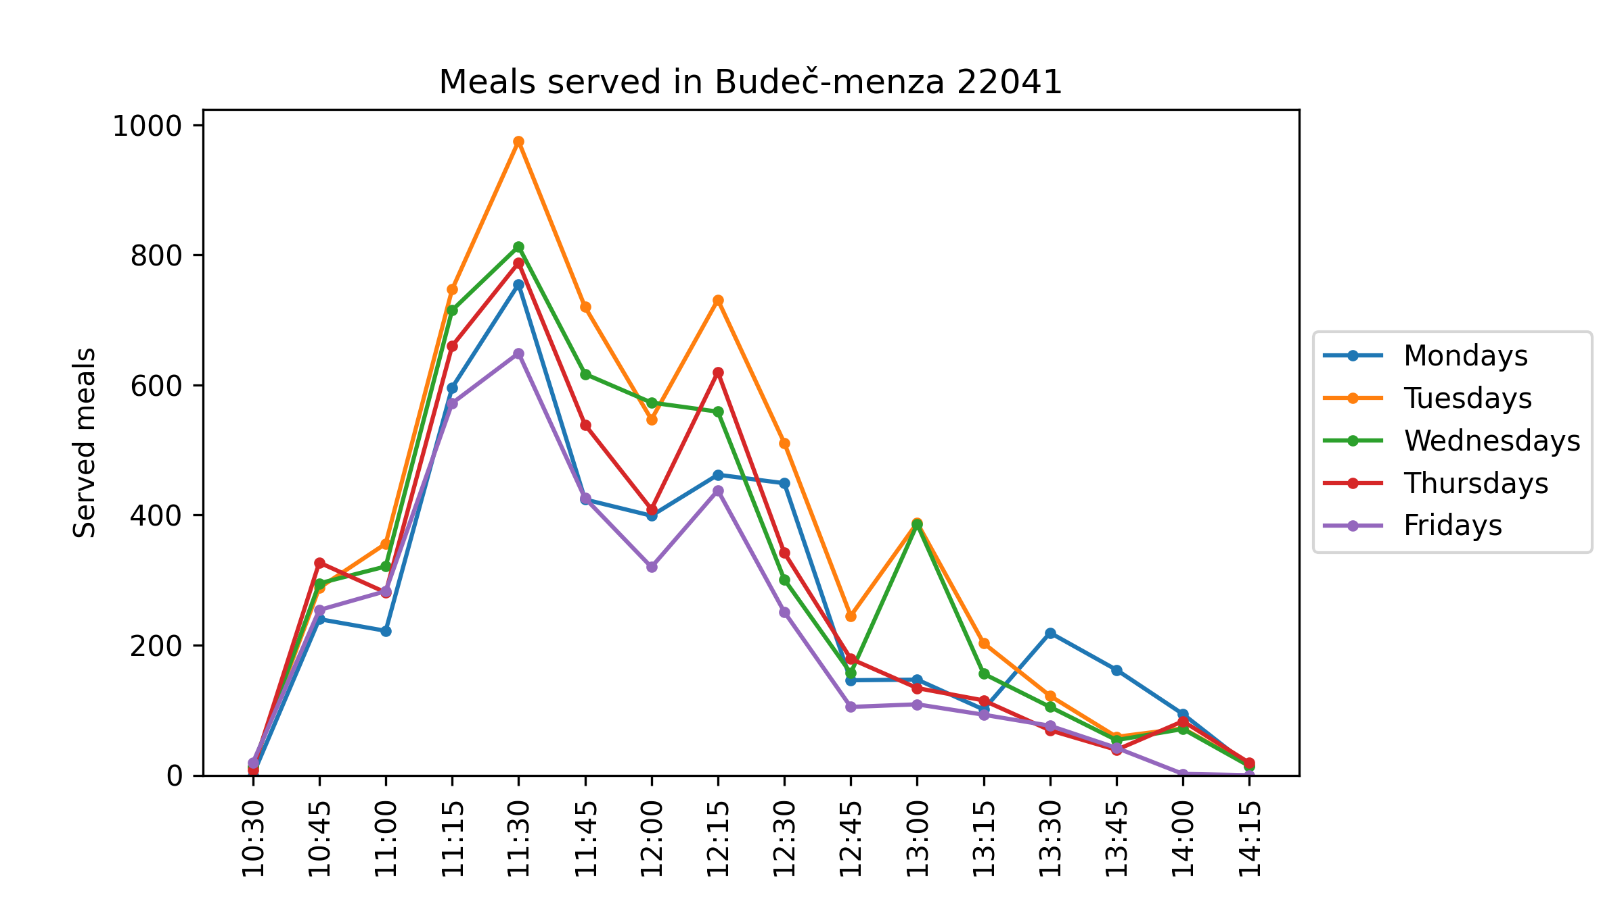
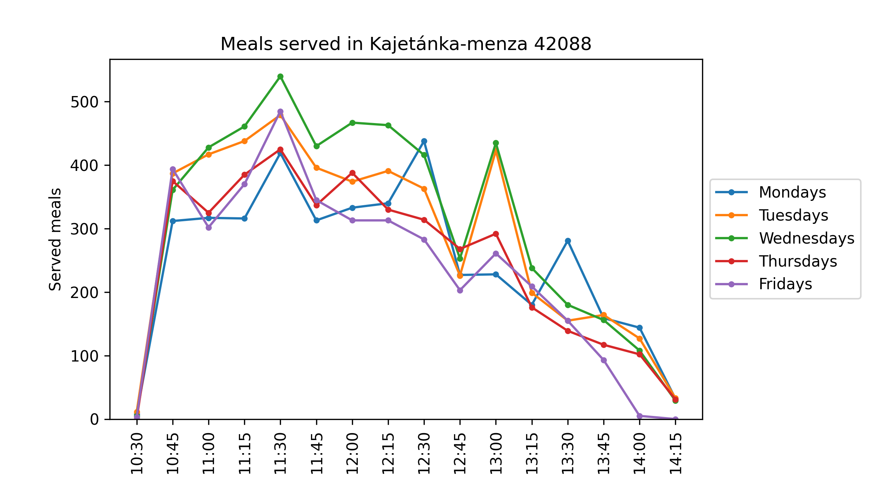
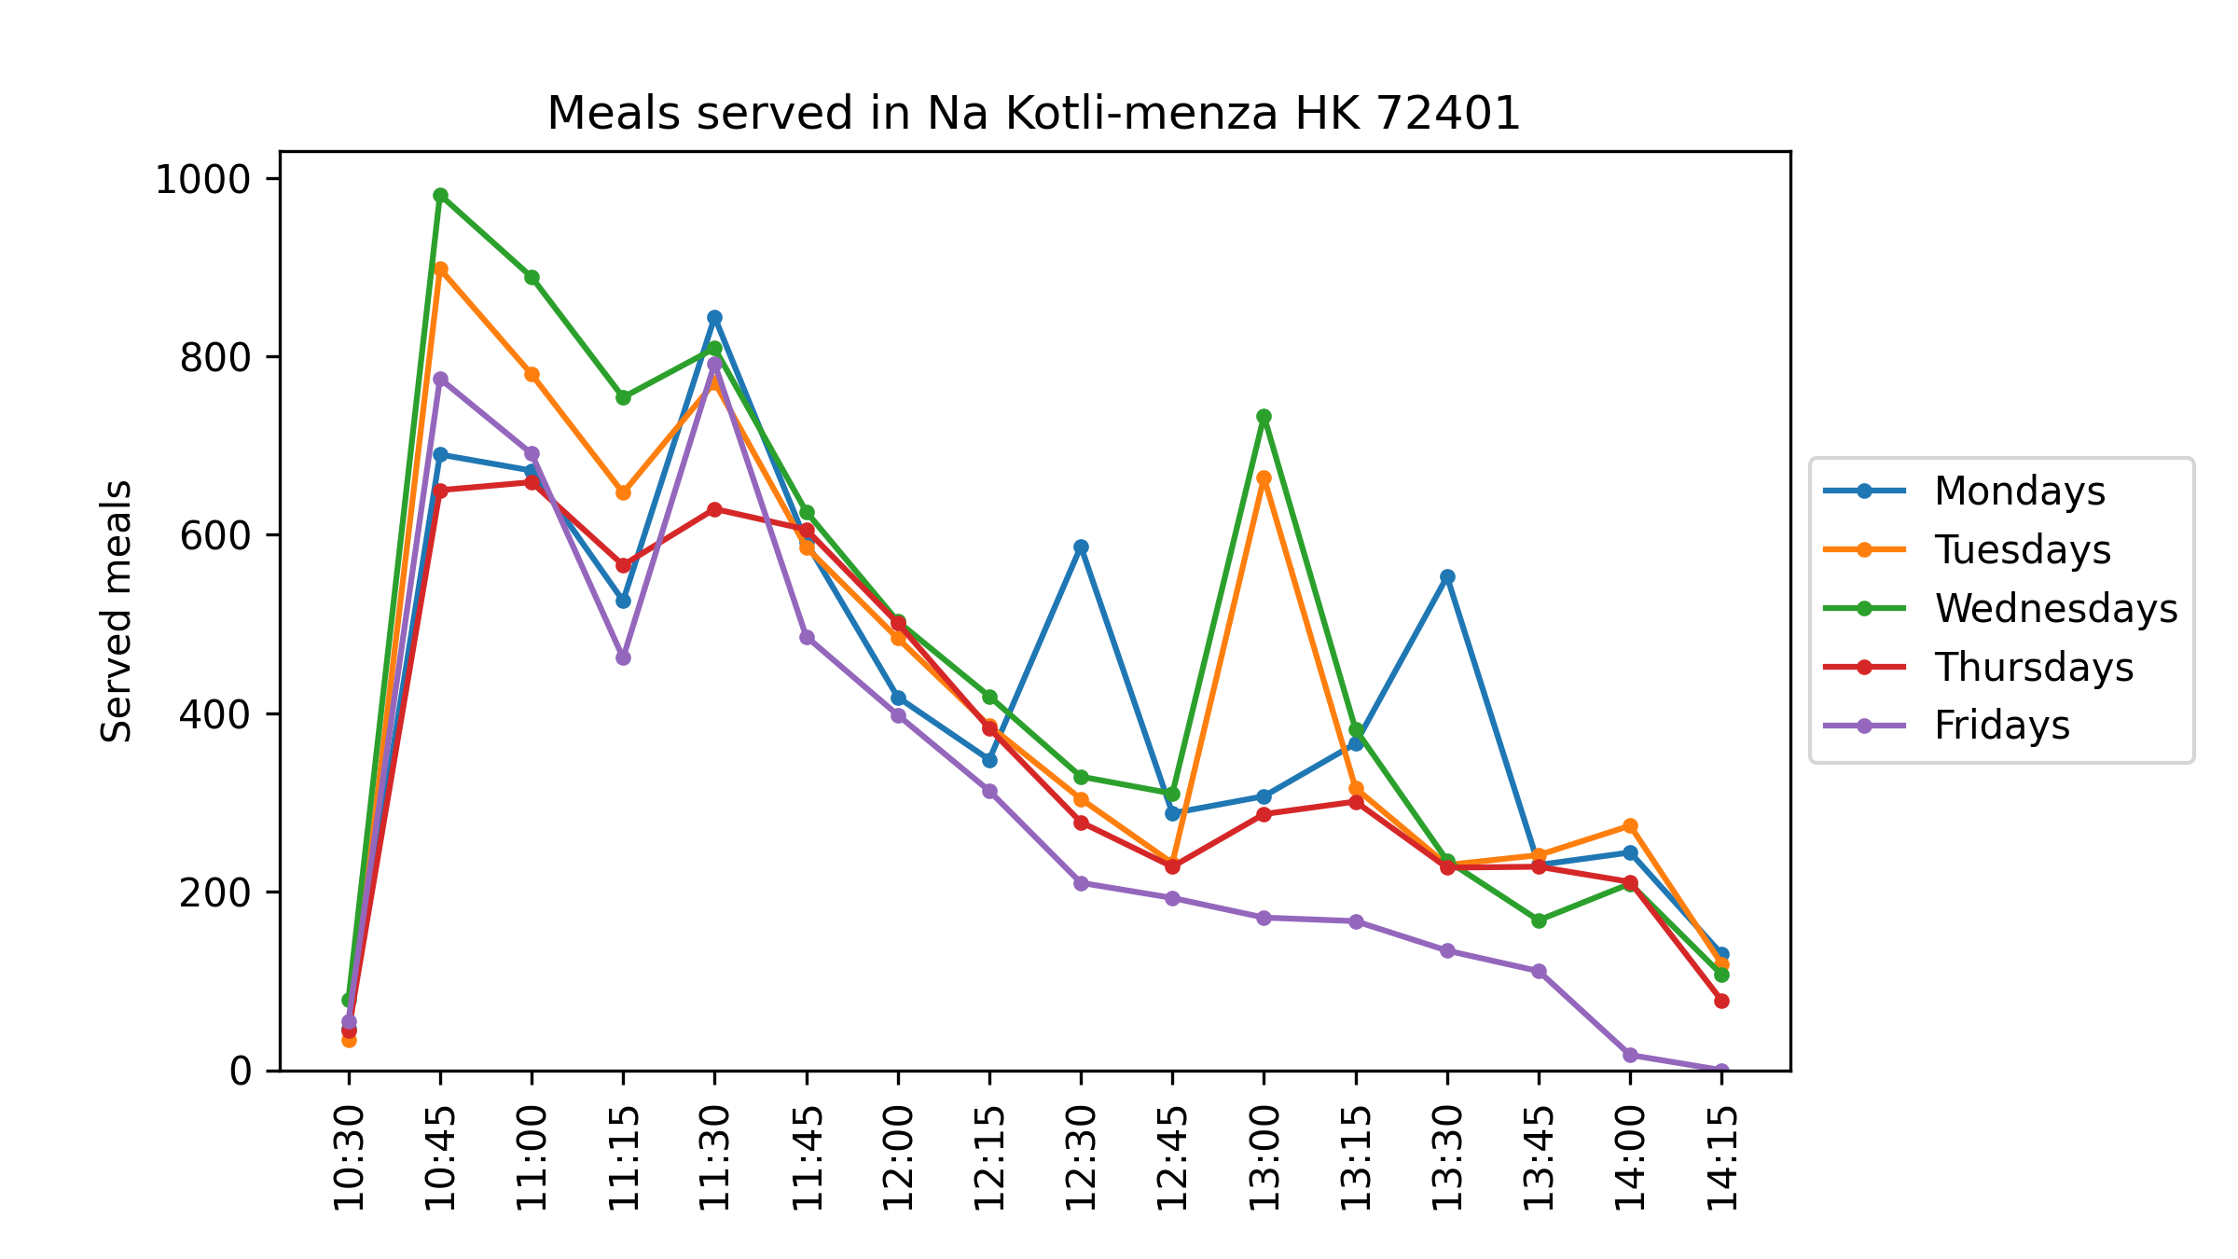

Slide 13
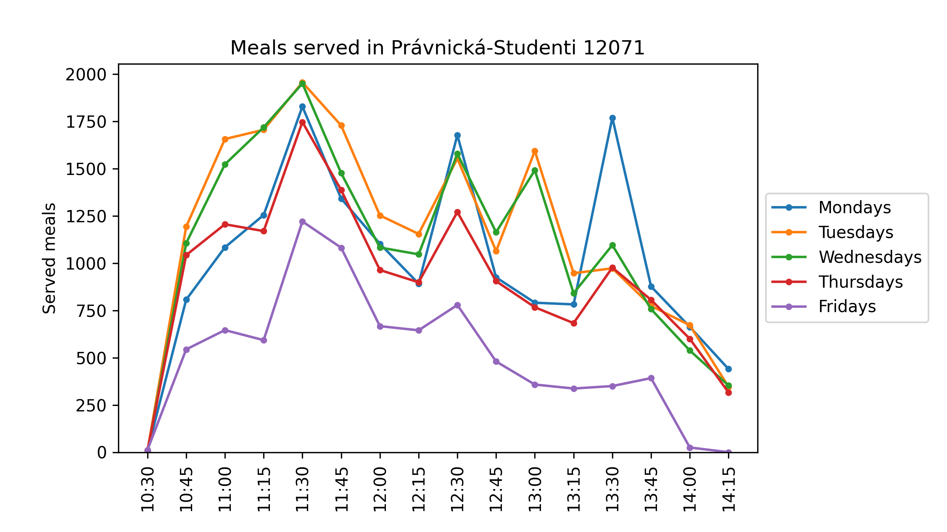
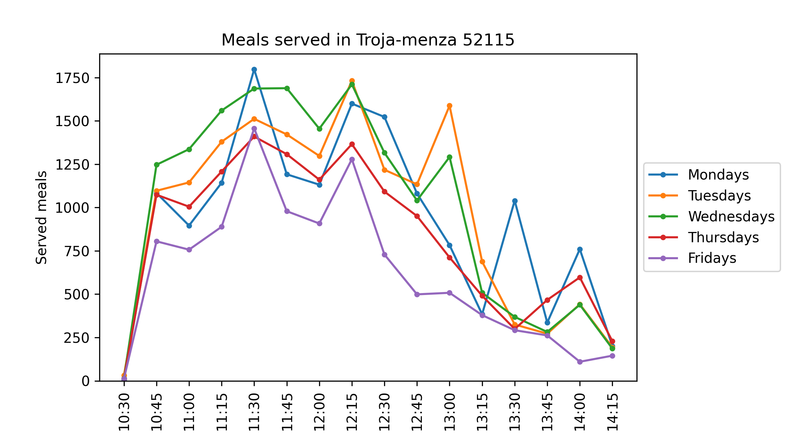
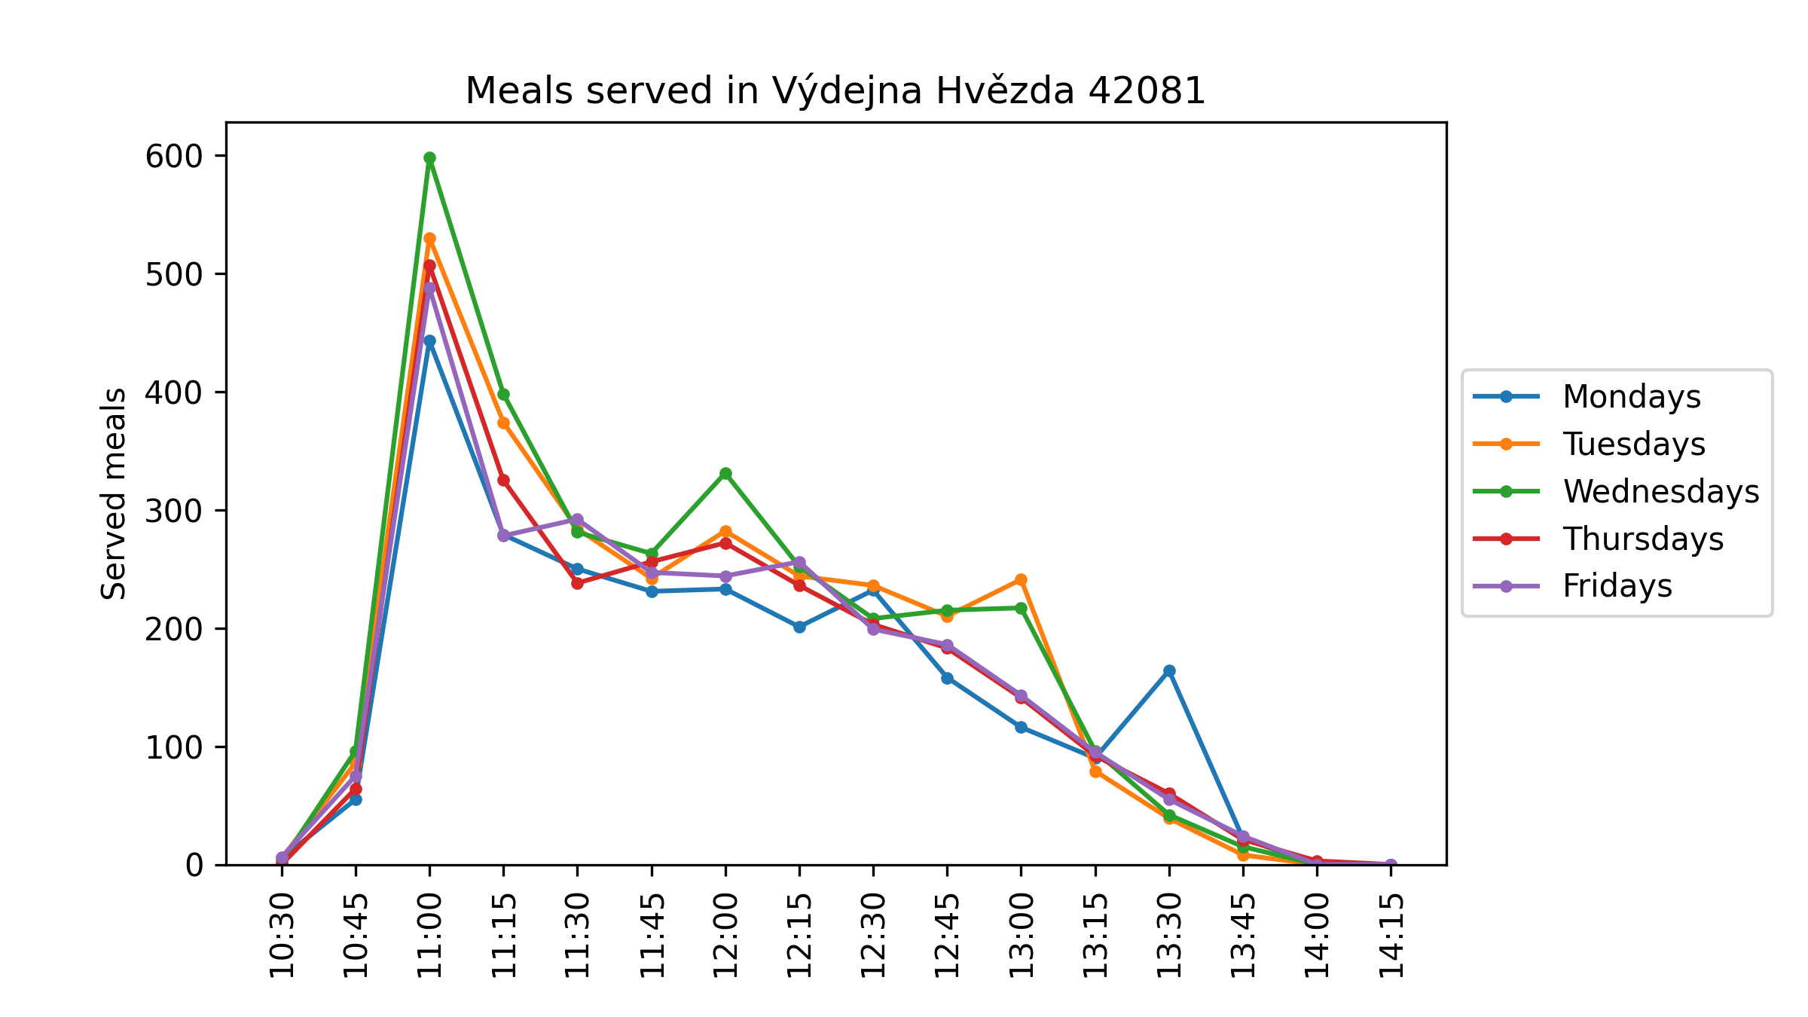

Slide 14
Wasted food
Wasted food – number of available meals at 14:30
Alt(ernatively computed) wasted food – last time with more than 0 available meals - 1

Slide 15
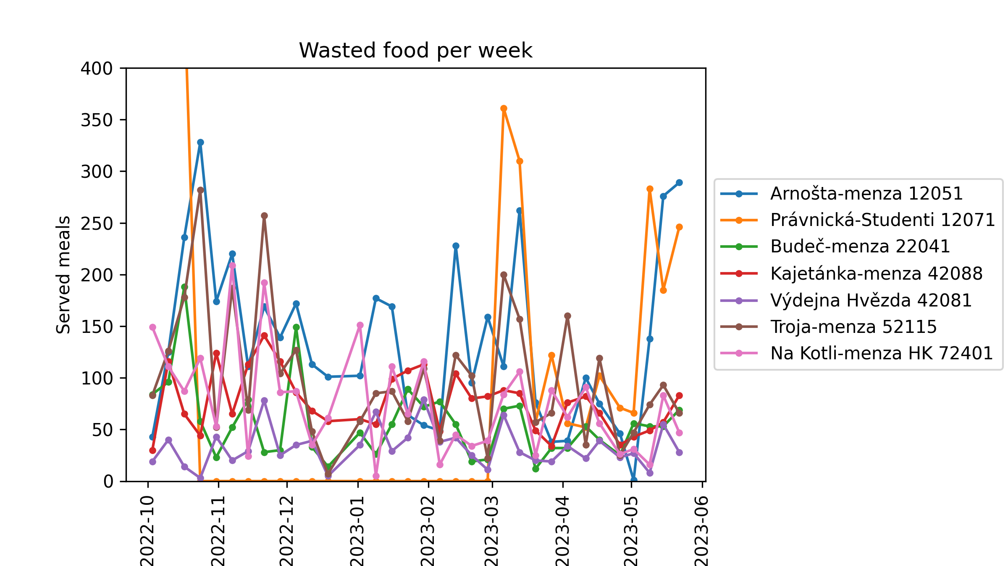
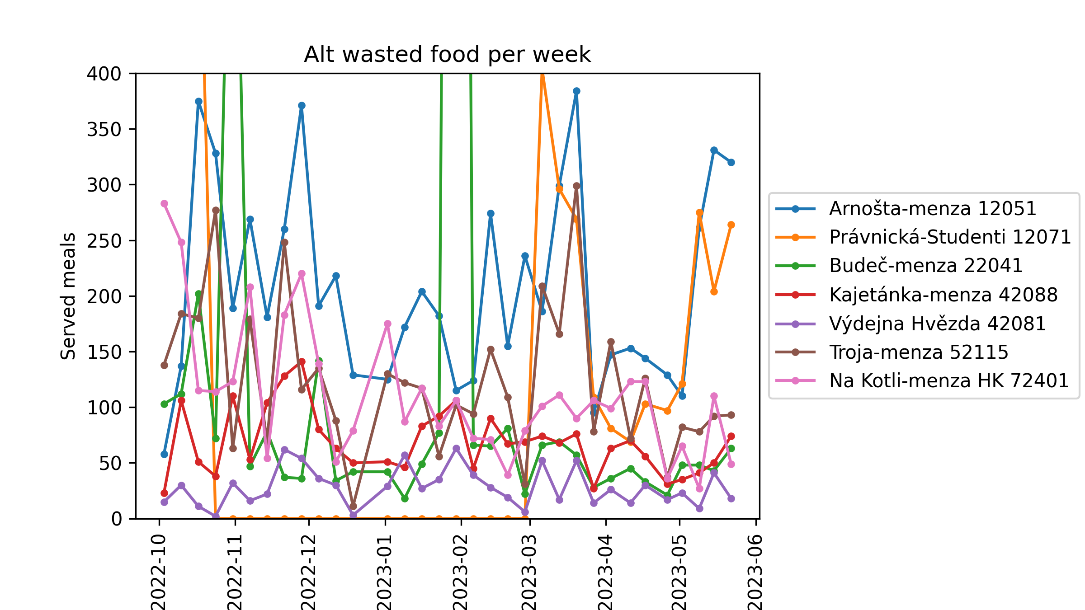

Slide 16
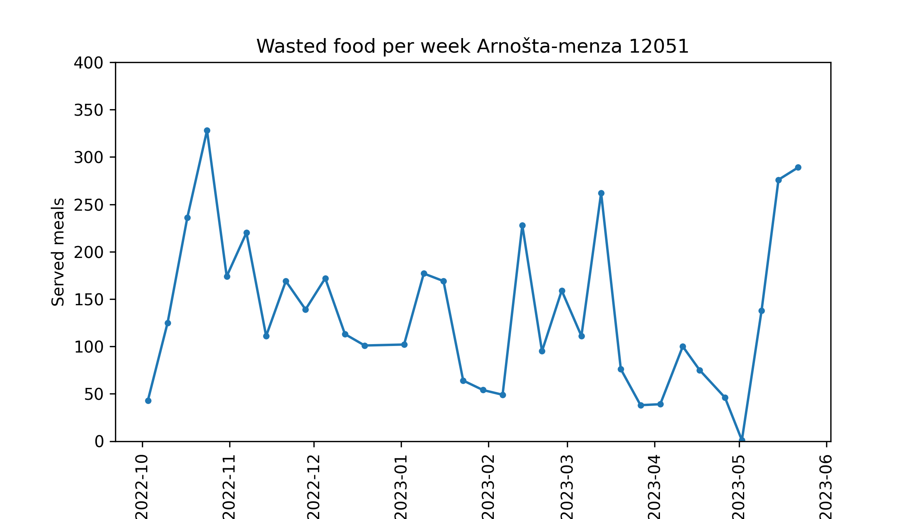
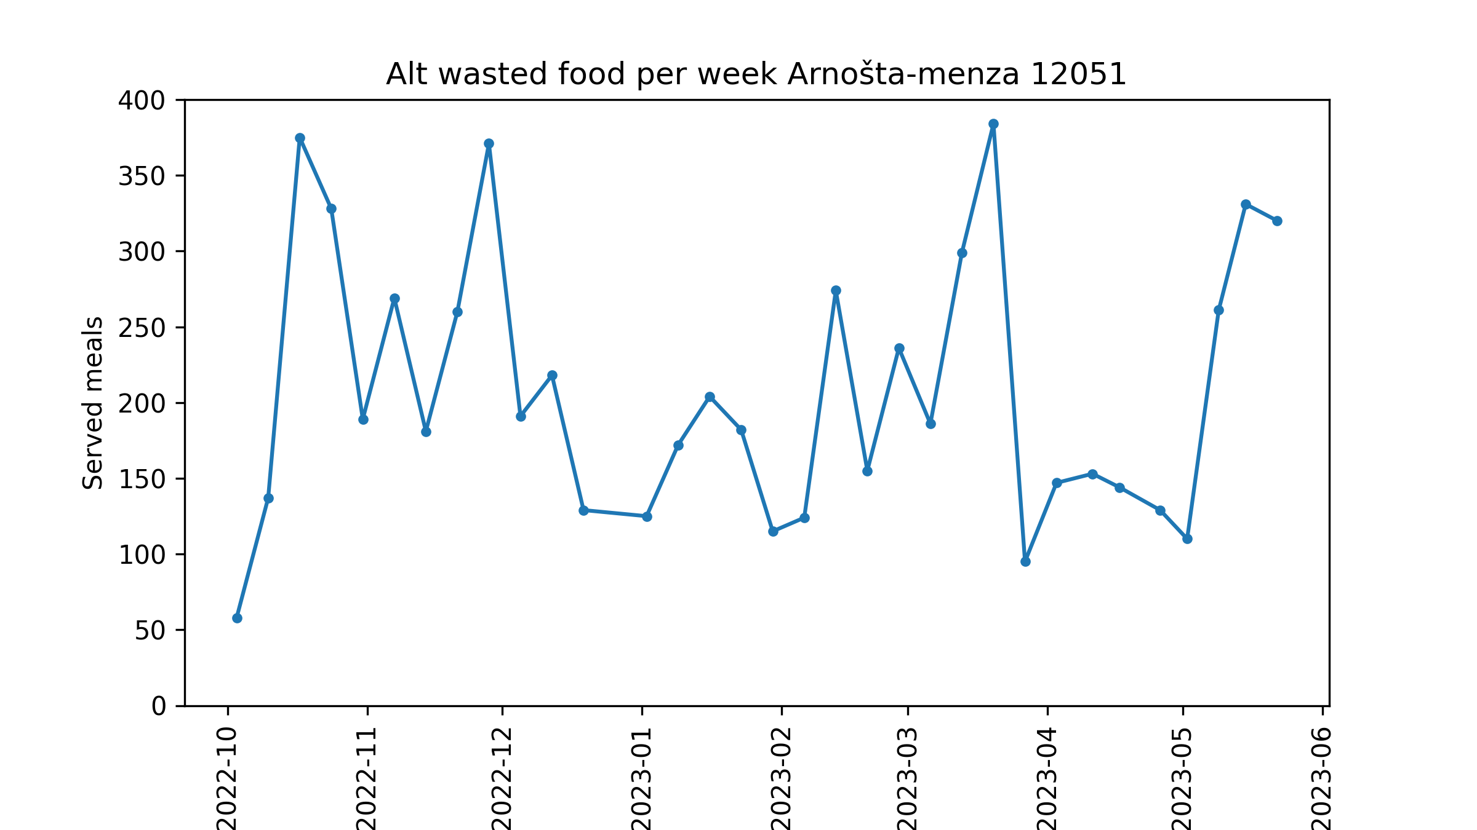
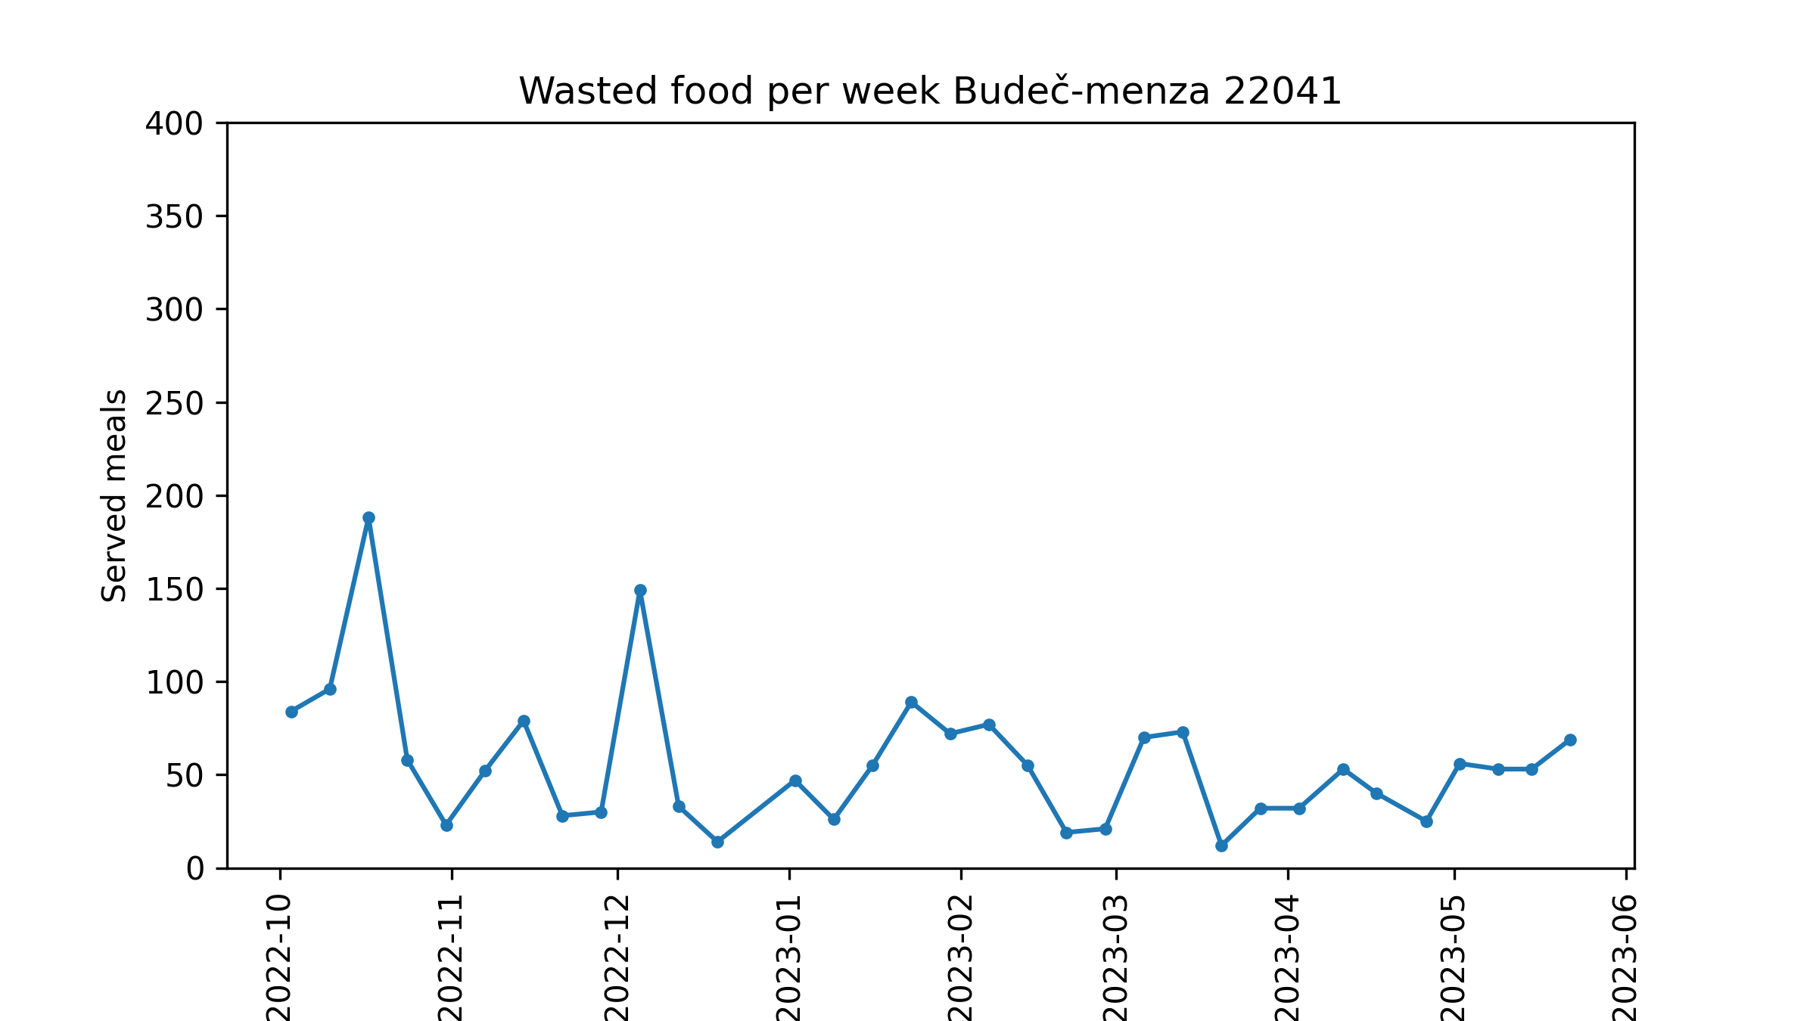
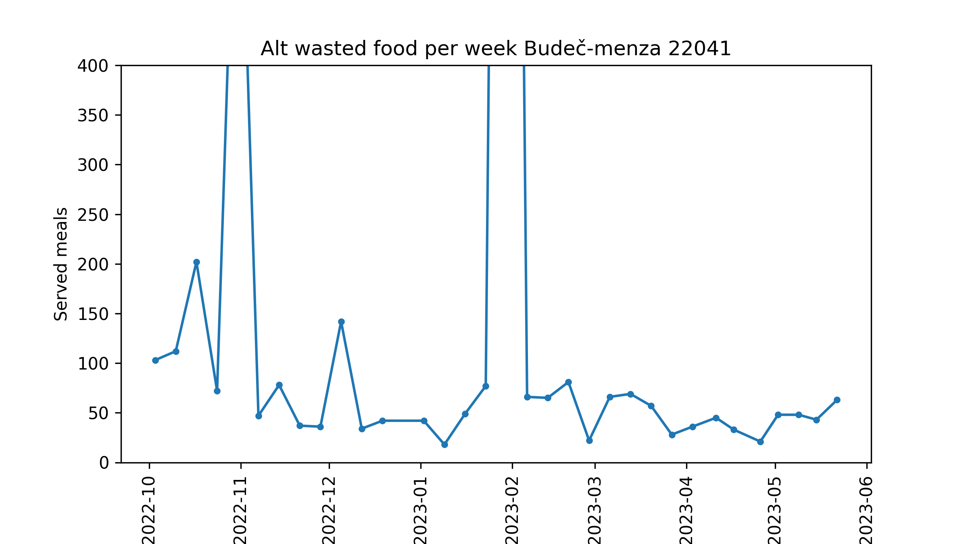

Slide 17
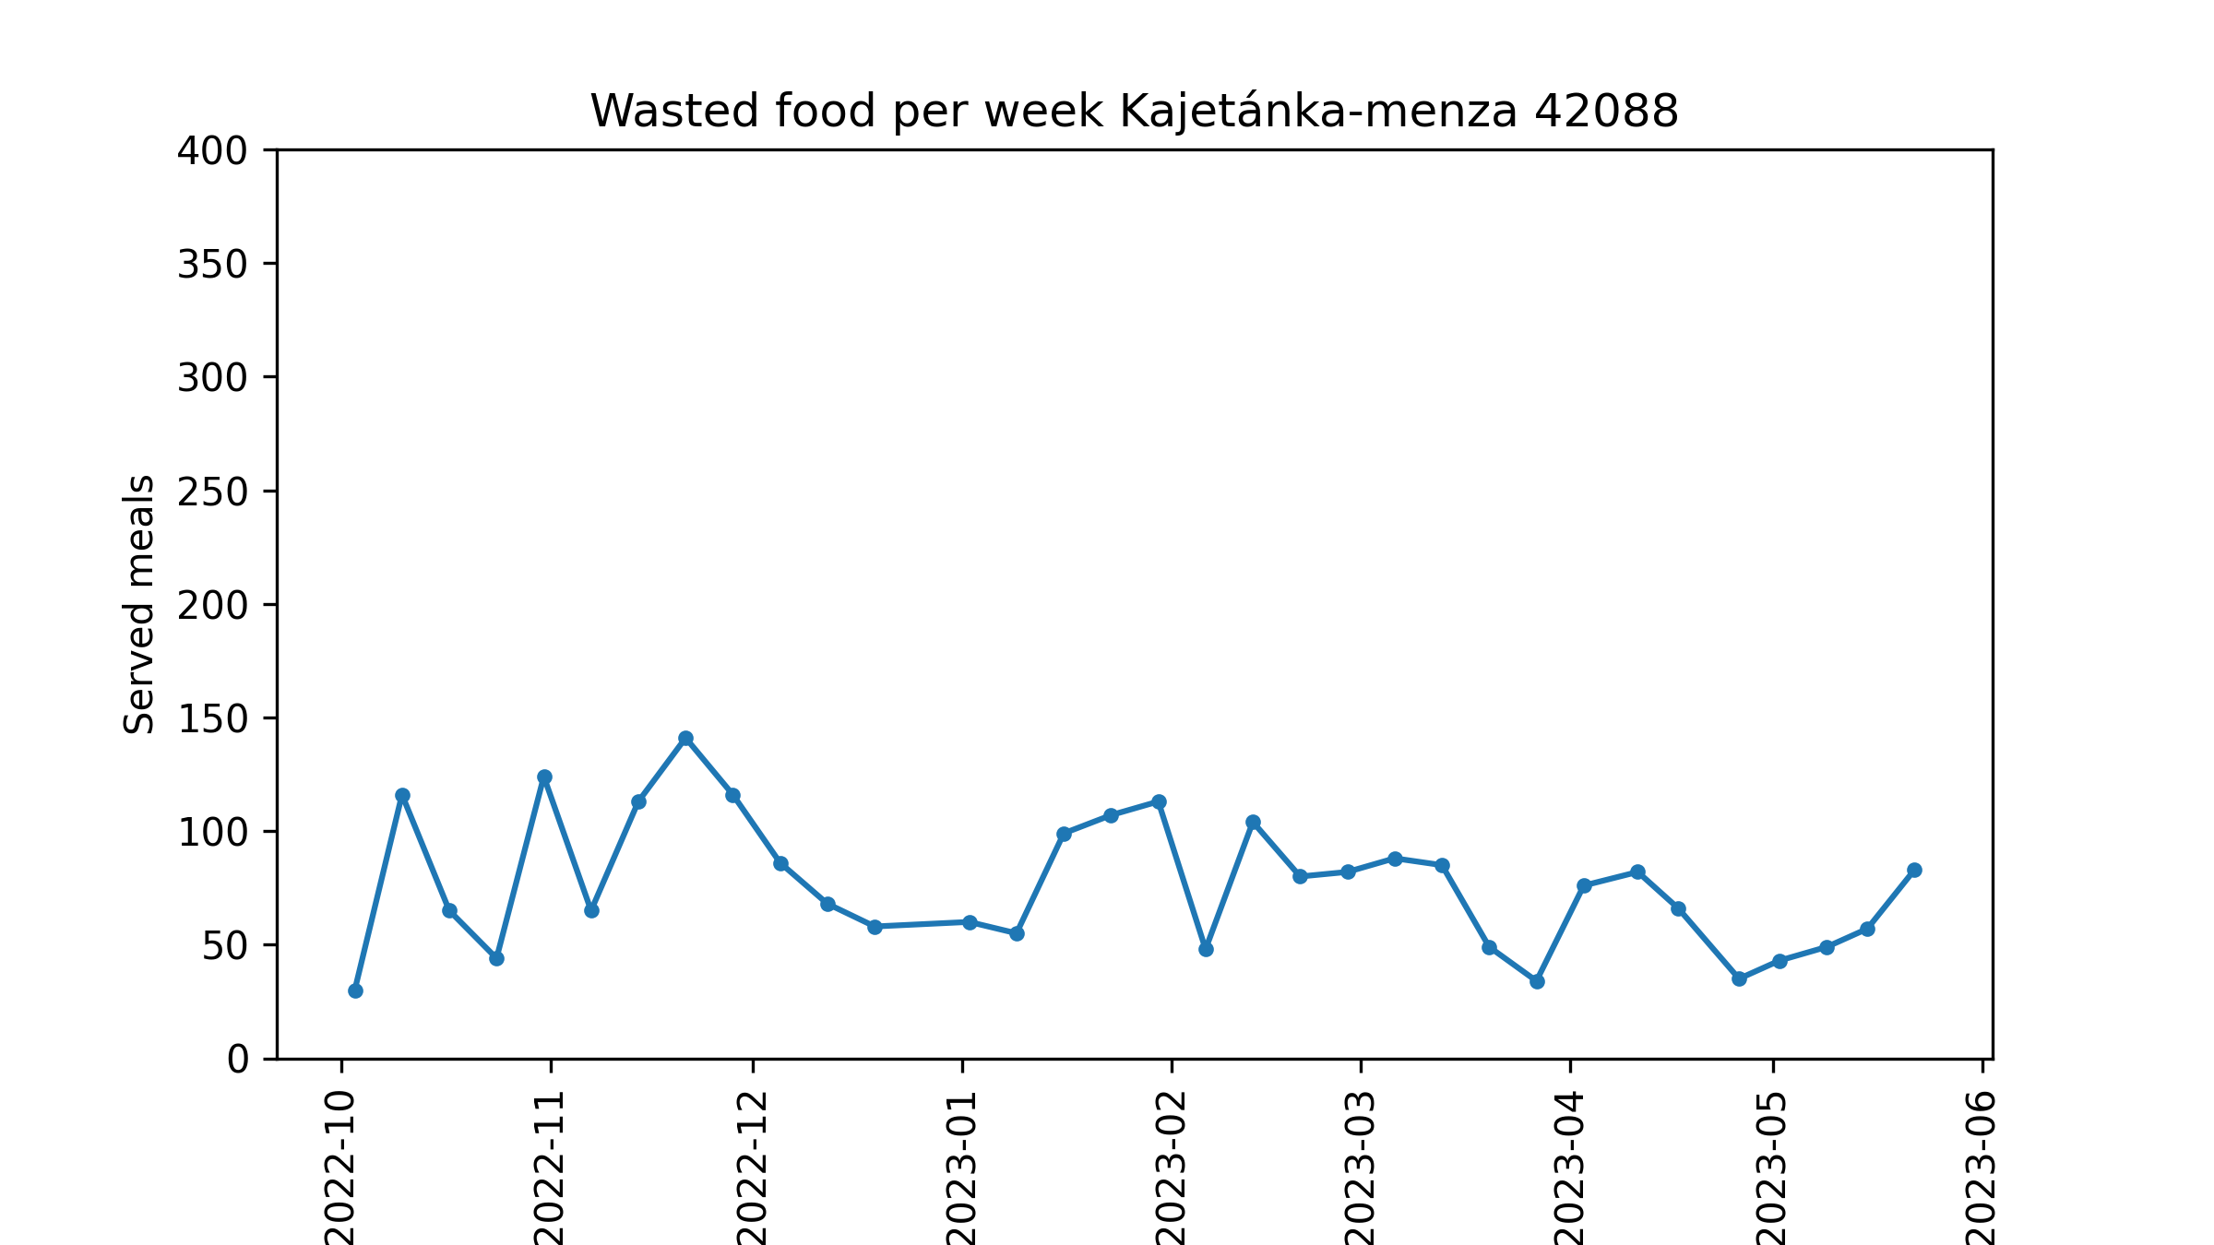
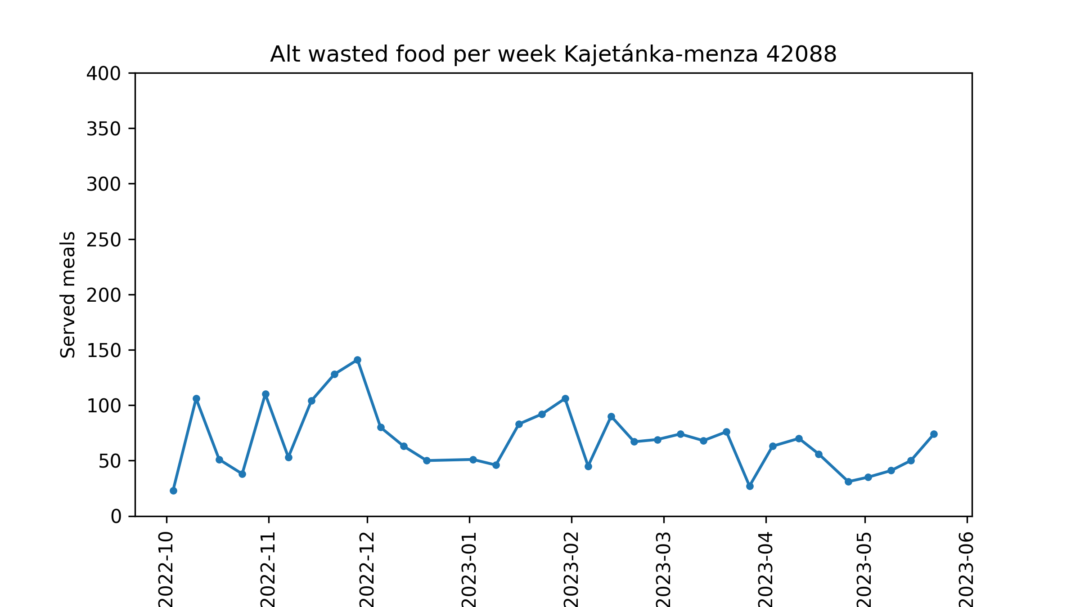
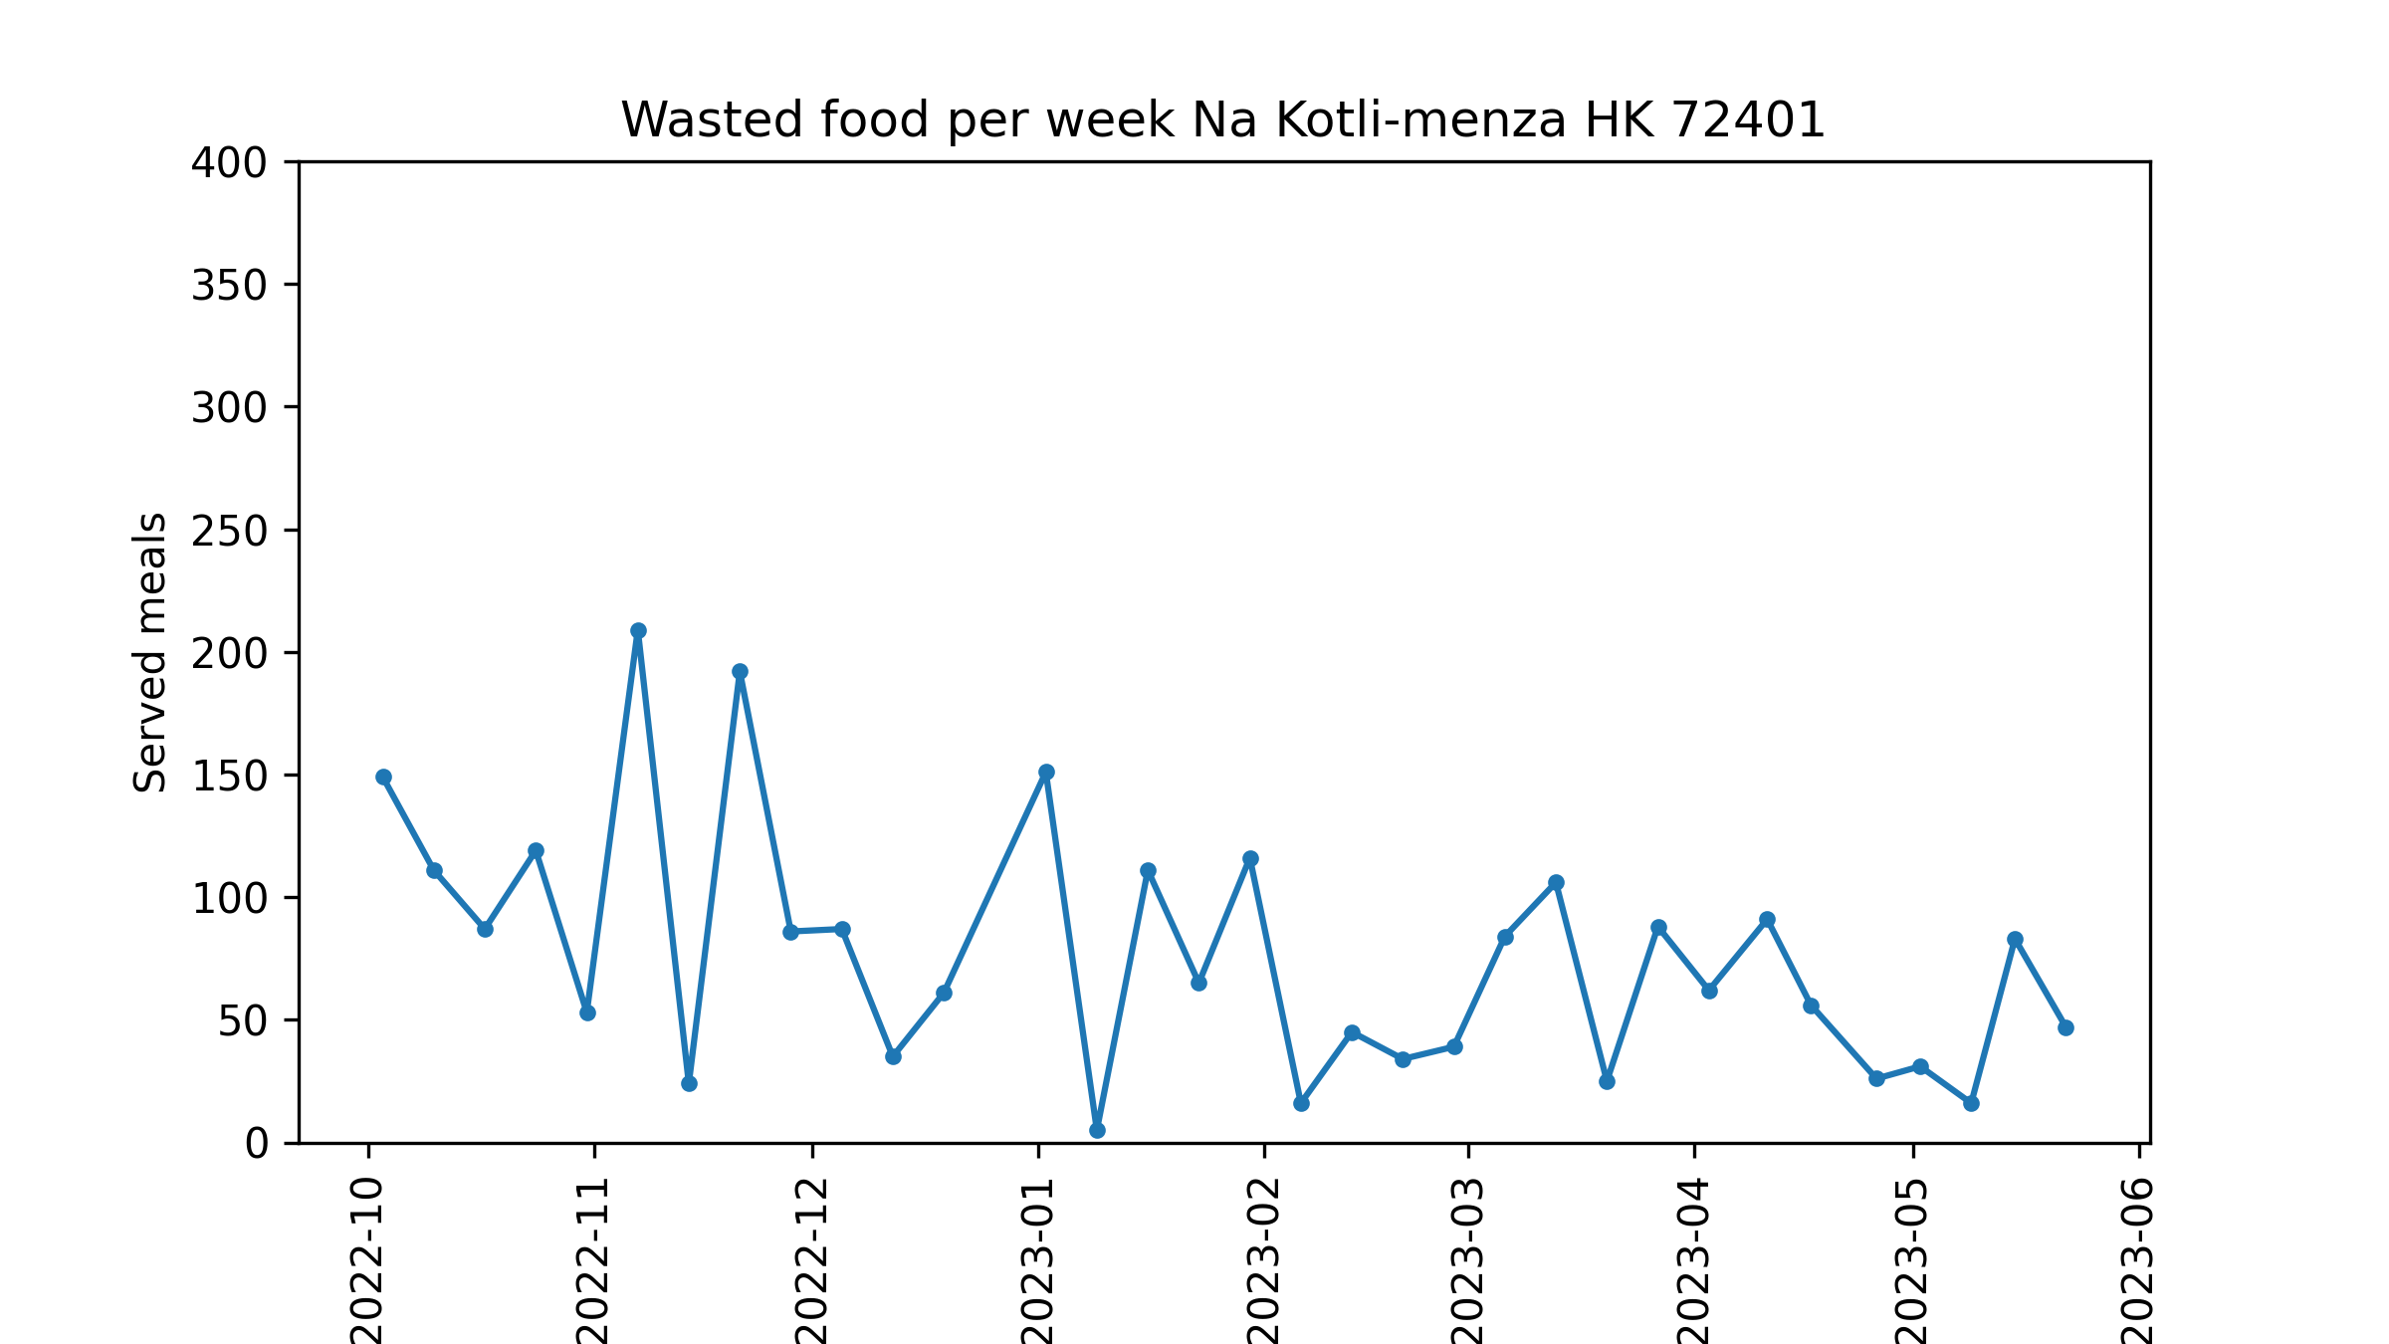
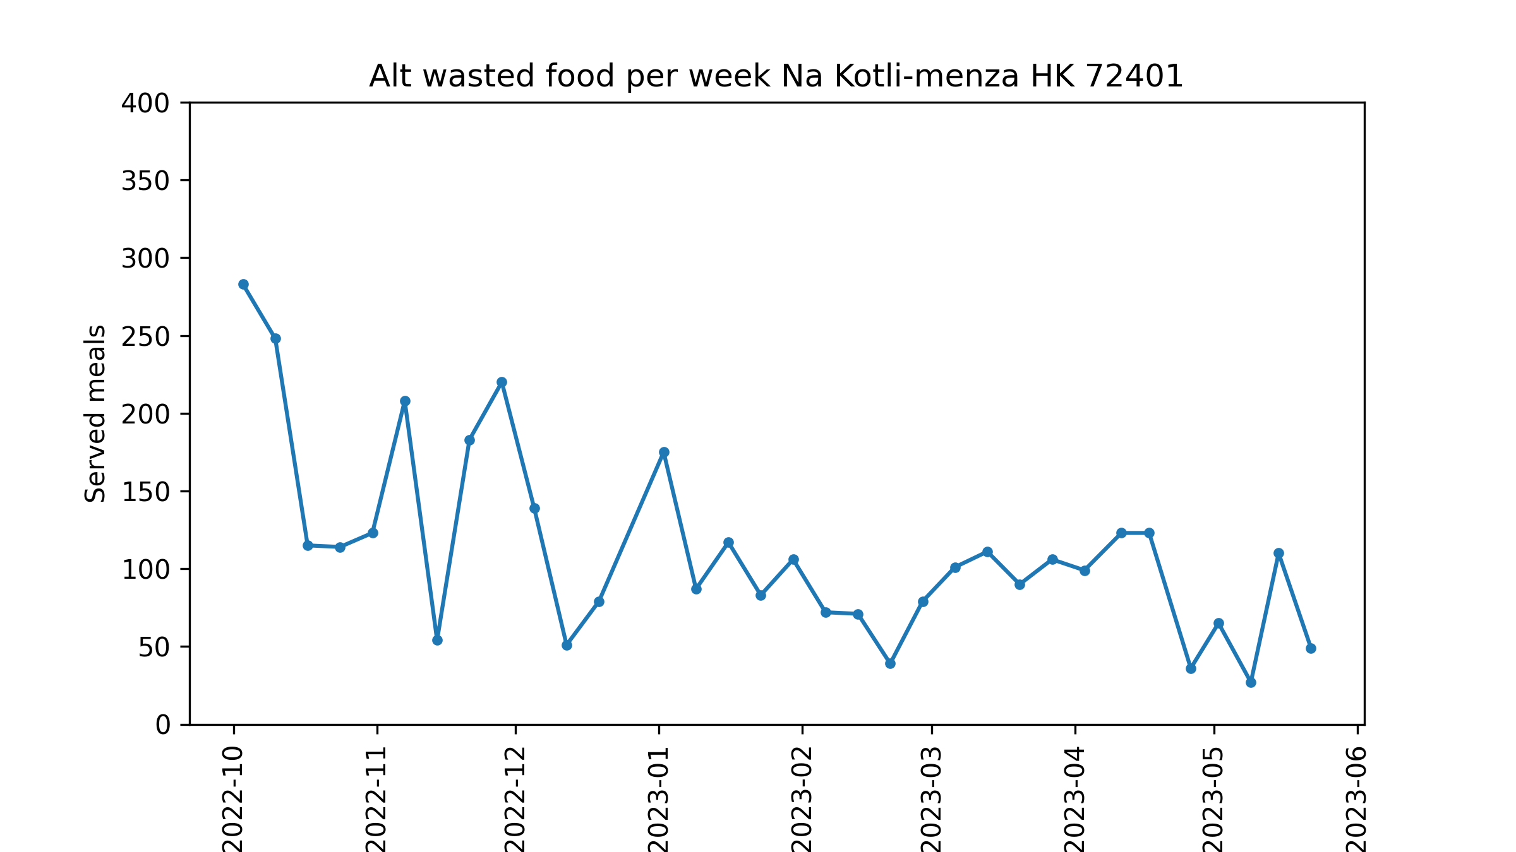

Slide 18
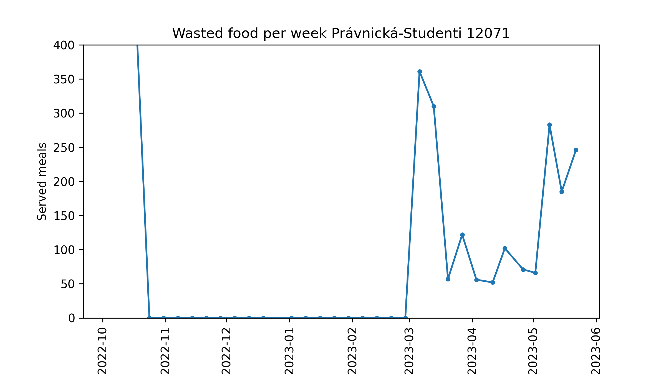
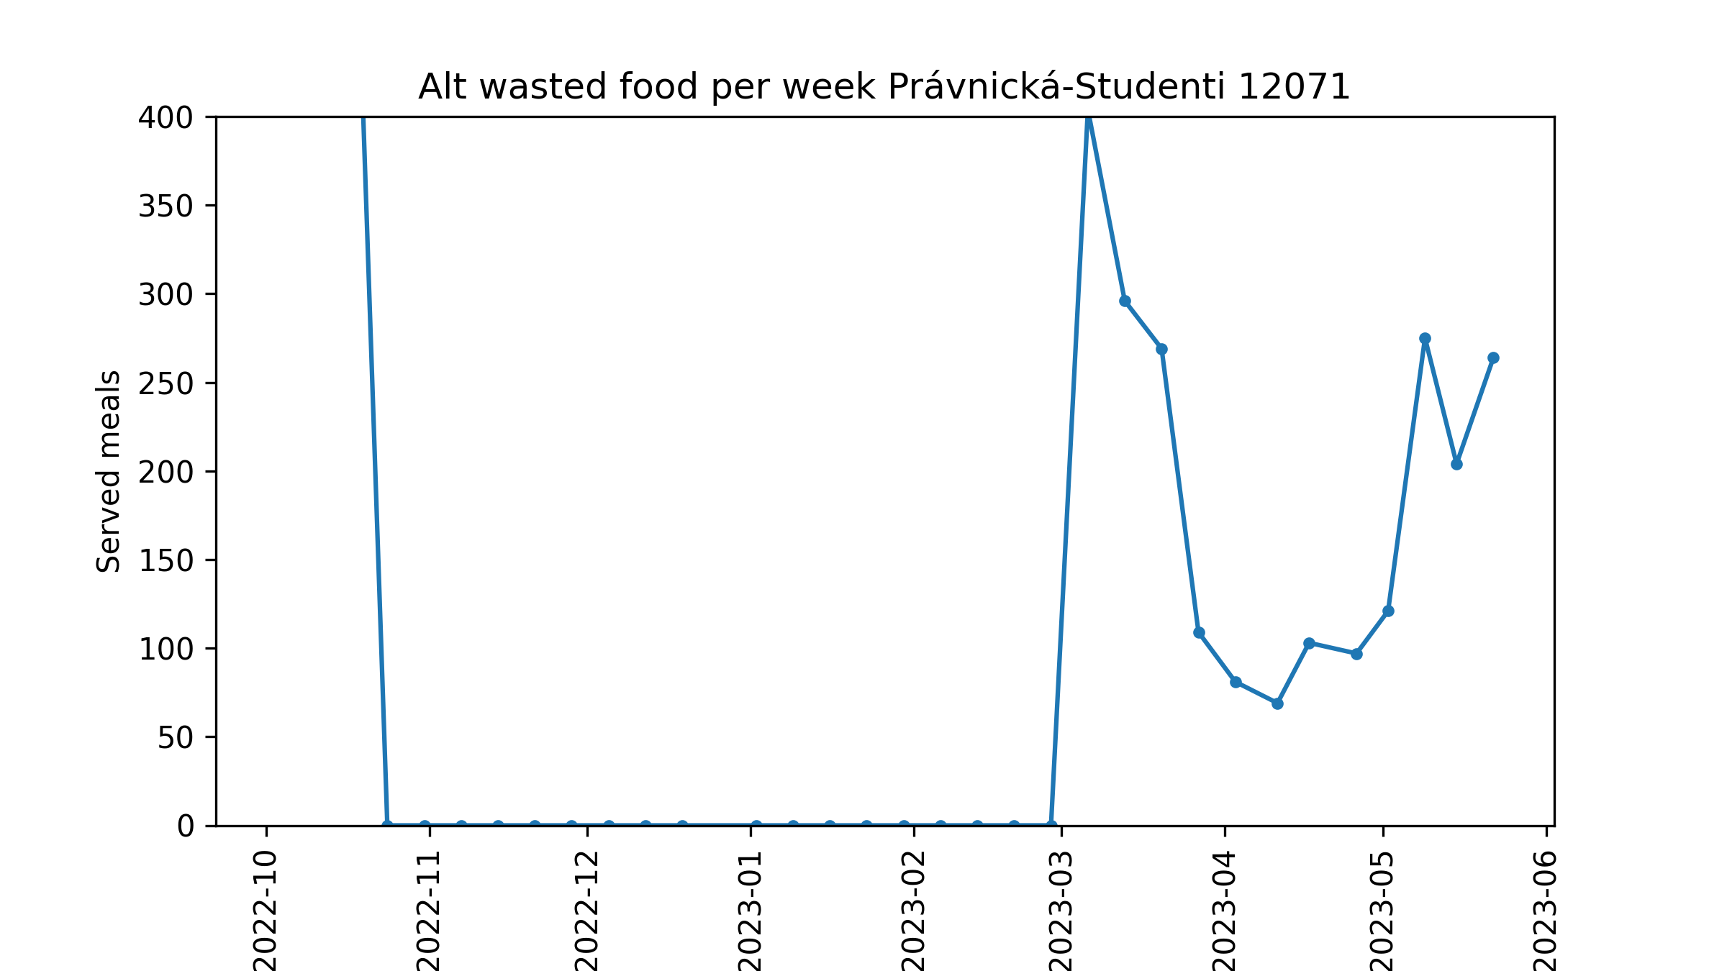
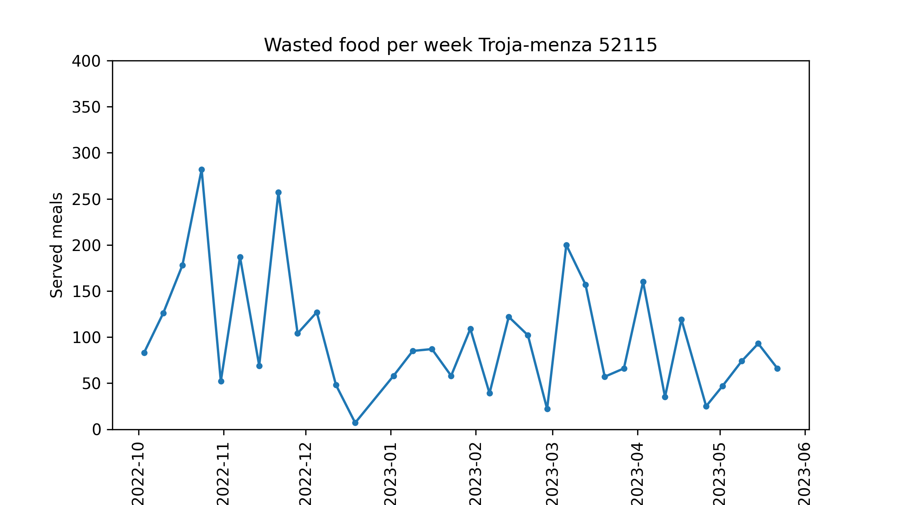
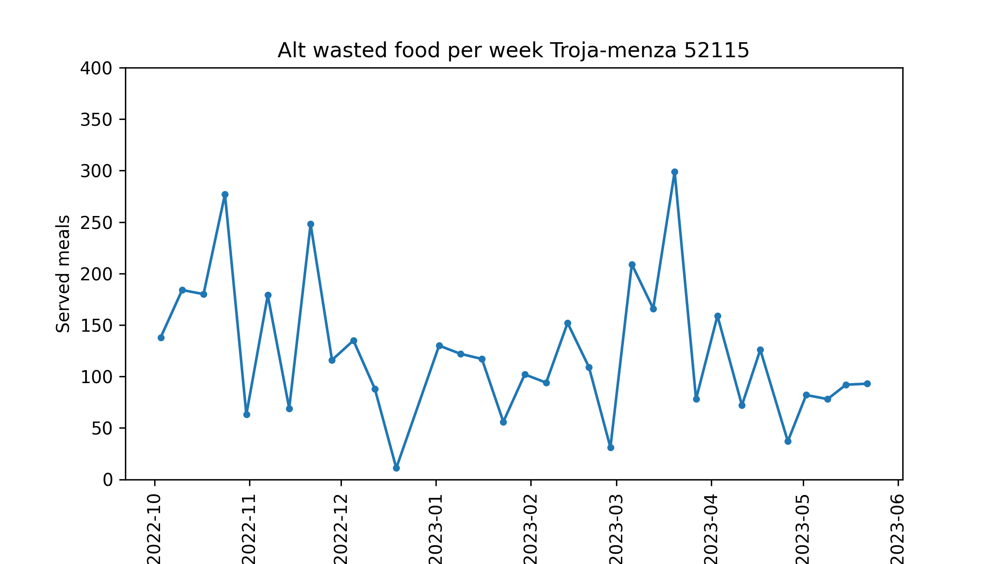
Notes:
Canteen Právnická marked available meals as -1 during half of the year

Slide 19
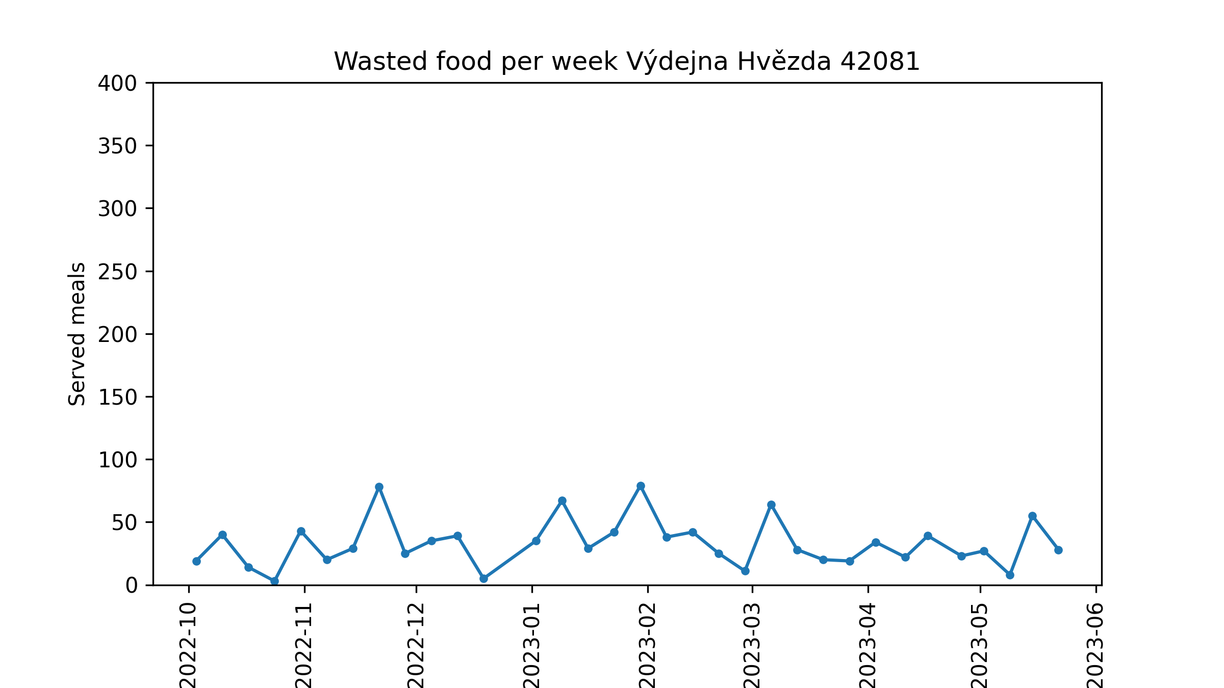
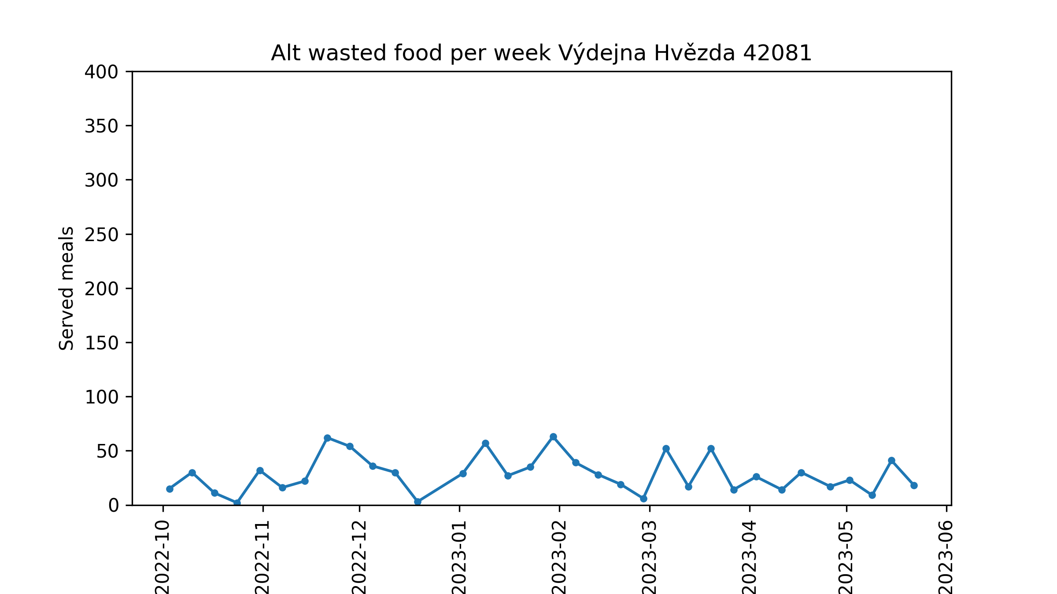

Slide 20
Score
How to measure food popularity?
Meal often runs out between 12:00 and 13:00
Given by number of cooked portions, might be replenished later in small amounts
Different amount of students across canteens
Different amount of students during the year
Different amount of students during the week (e.g. Fridays)
Difference between number of available options
For every small interval (15 minutes) compute ratio of served food option to all served food
Multiply by number of food options available during (almost all) the interval
For every food option take average of those micro-scores
Separately for every canteen

Slide 21
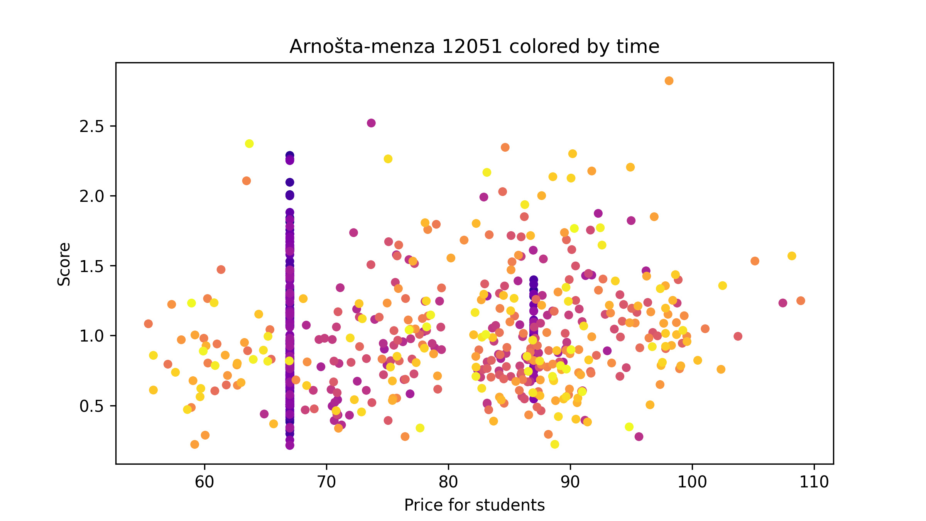
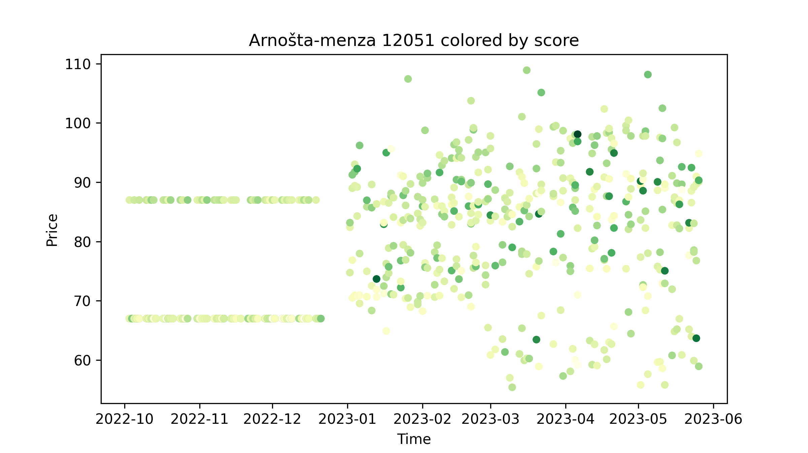
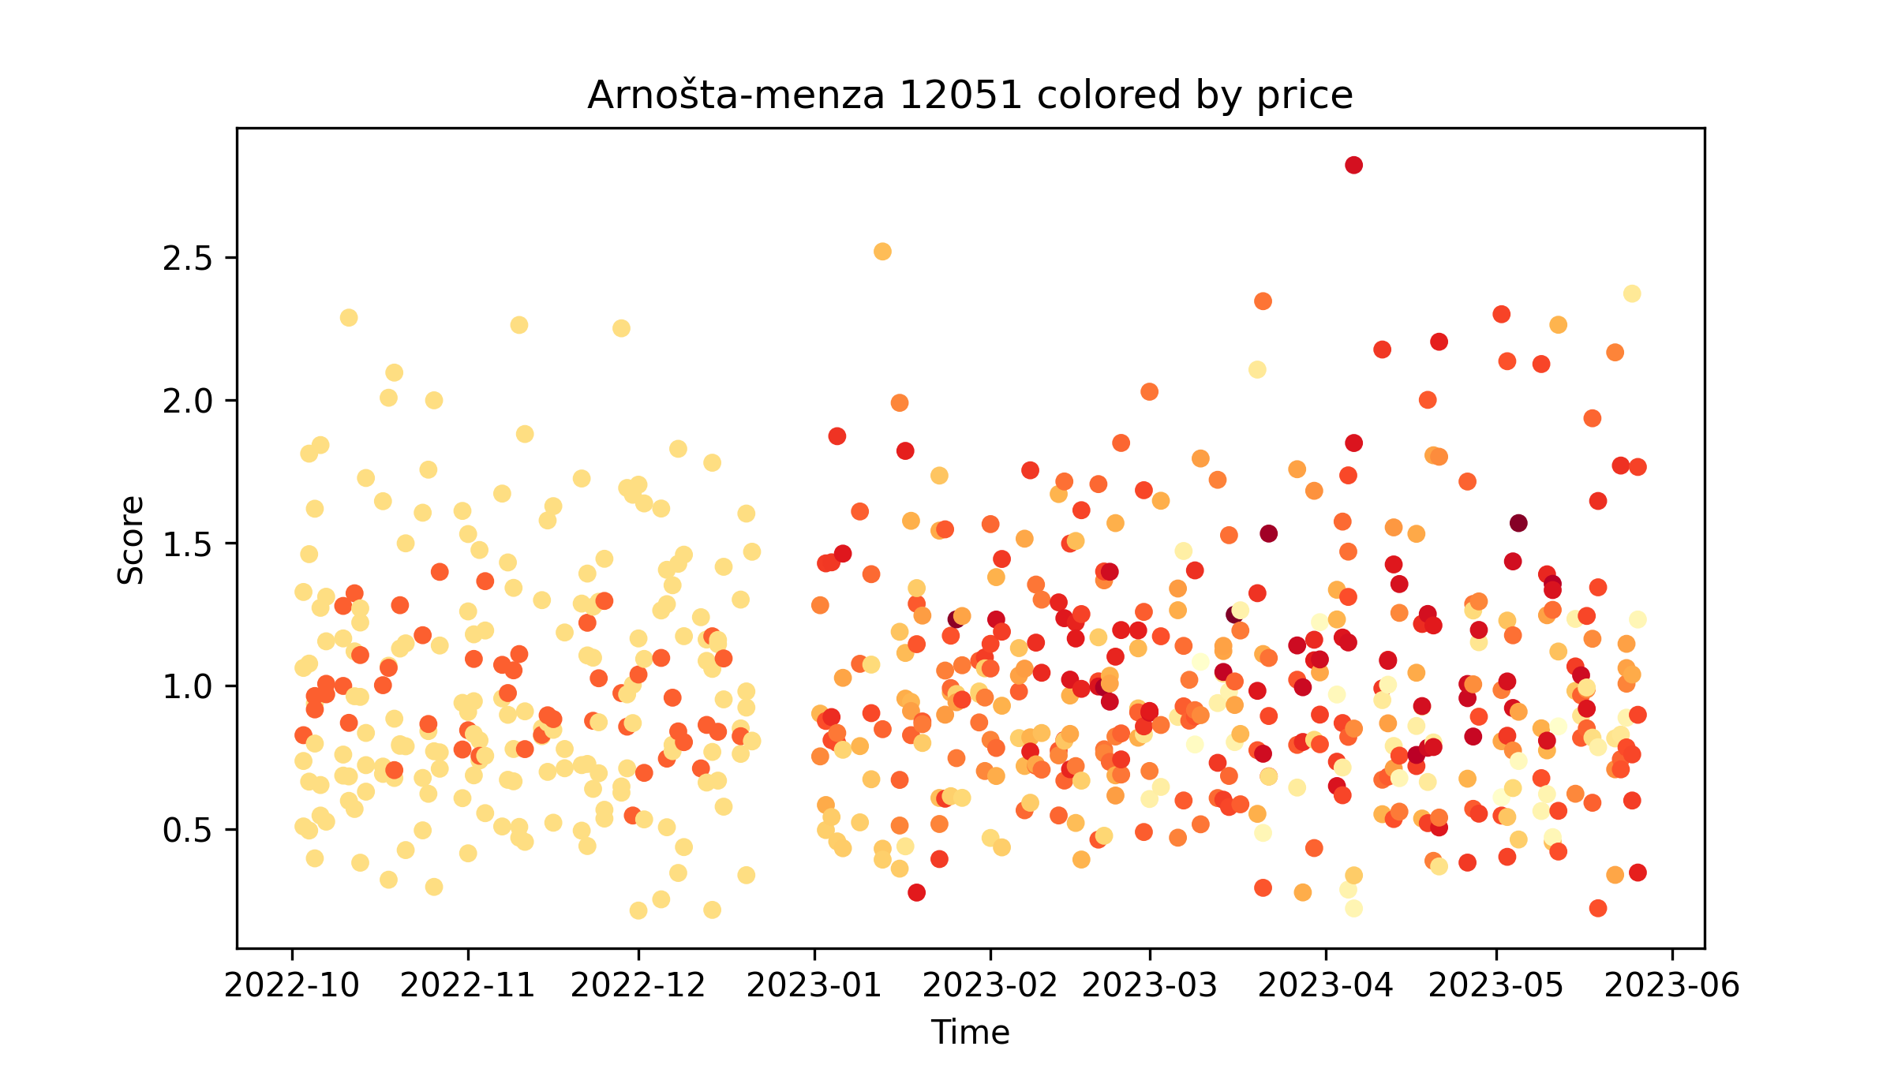
Notes:
1st plot – colored by time – earliest (October/November) are violet/blue, latest (April/May) are yellow
2nd plot – colored by score – the higher the score, the more (dark) green the point is
3rd plot – highest price is dark red, lowest is light yellow

Slide 22
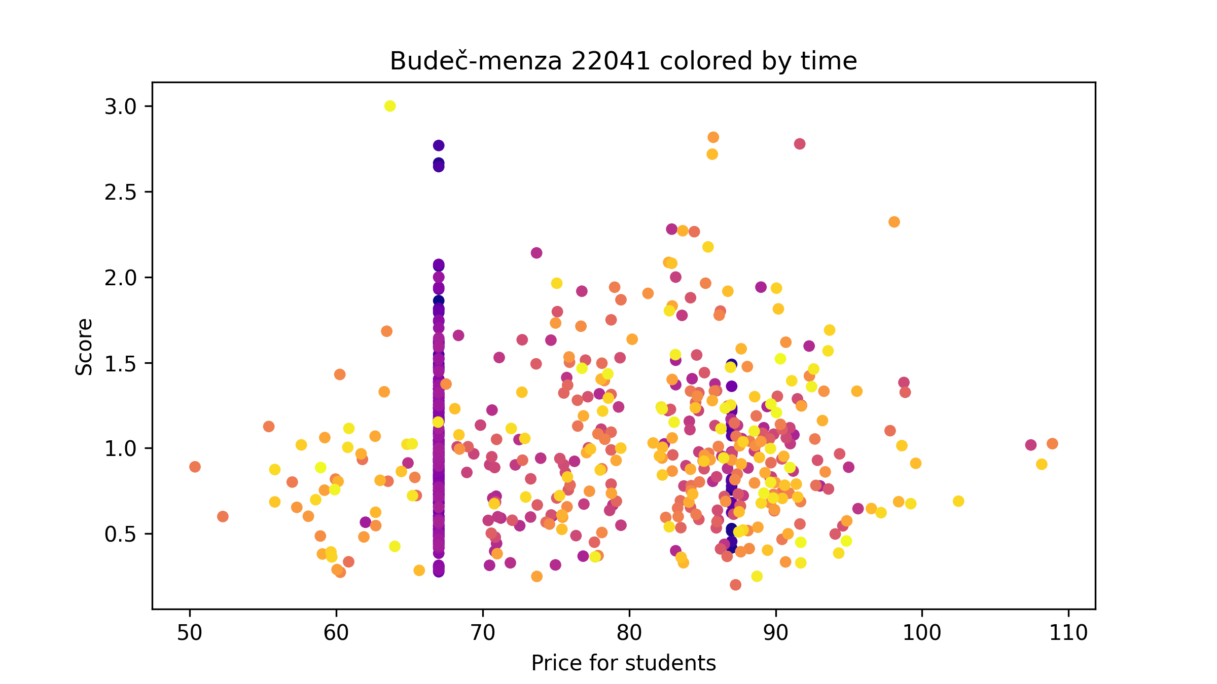
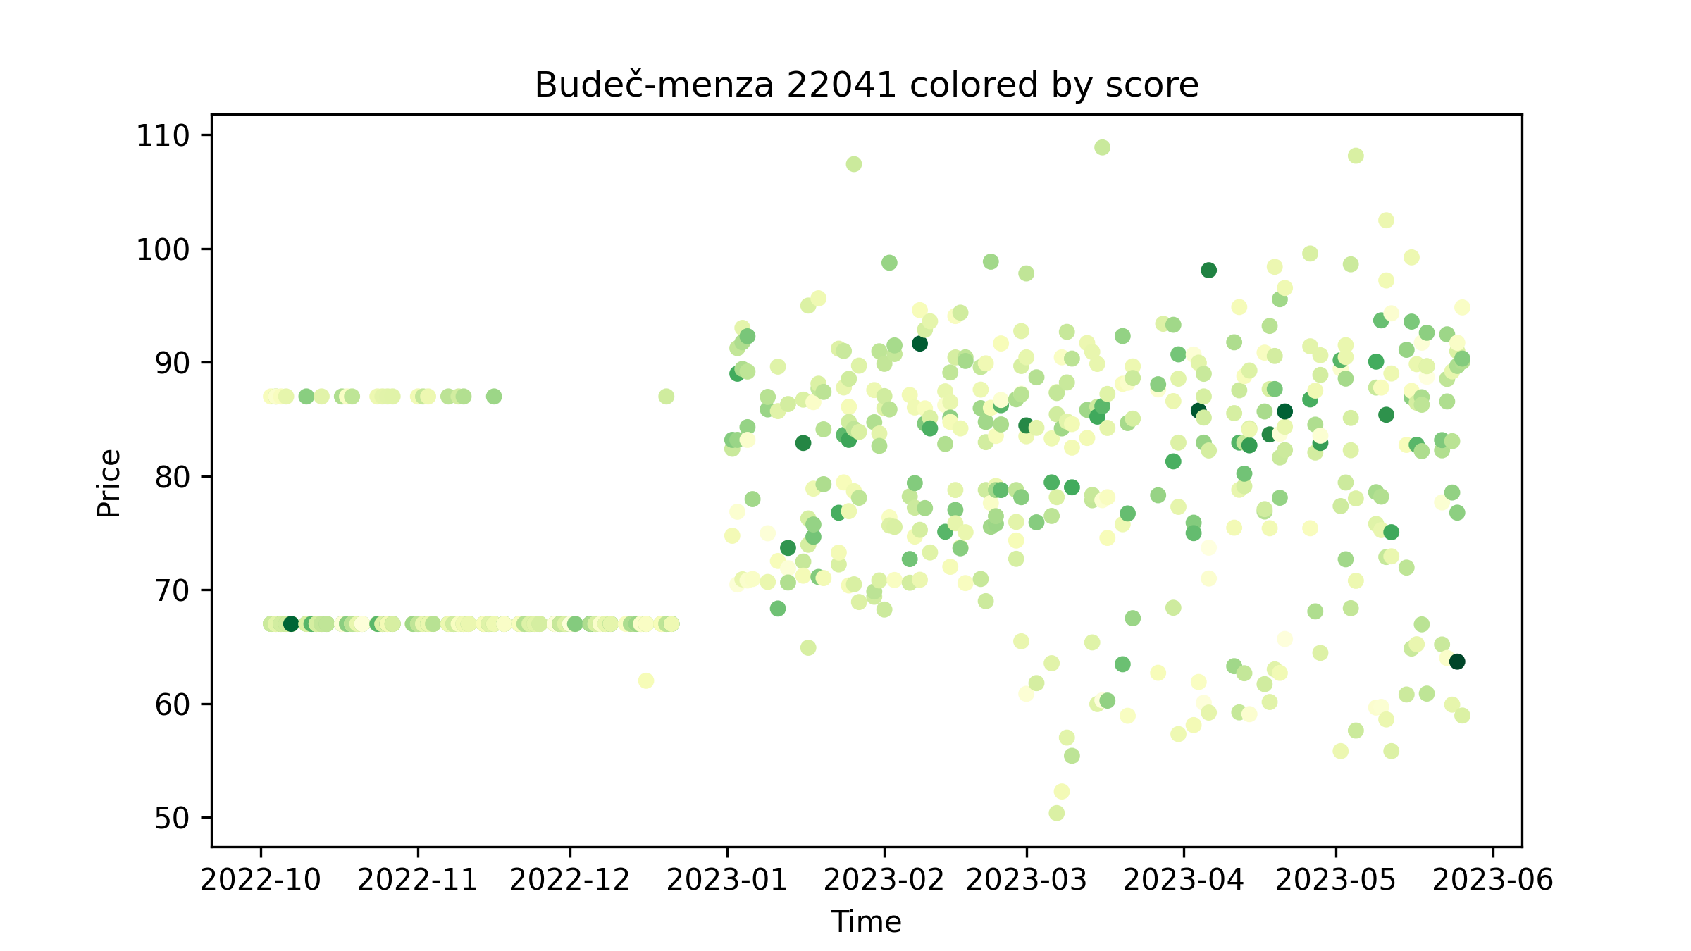
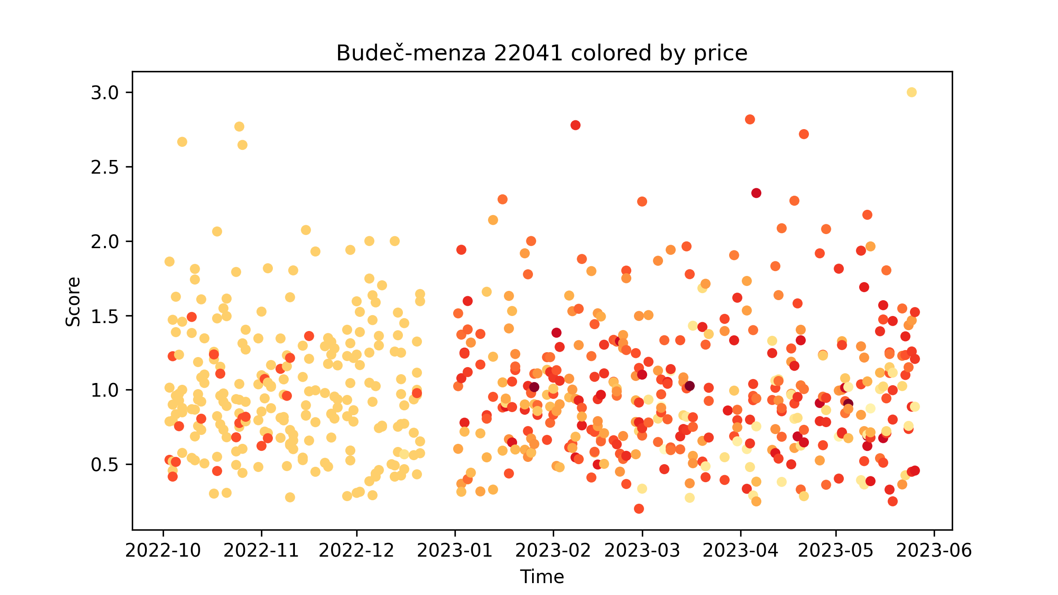

Slide 23
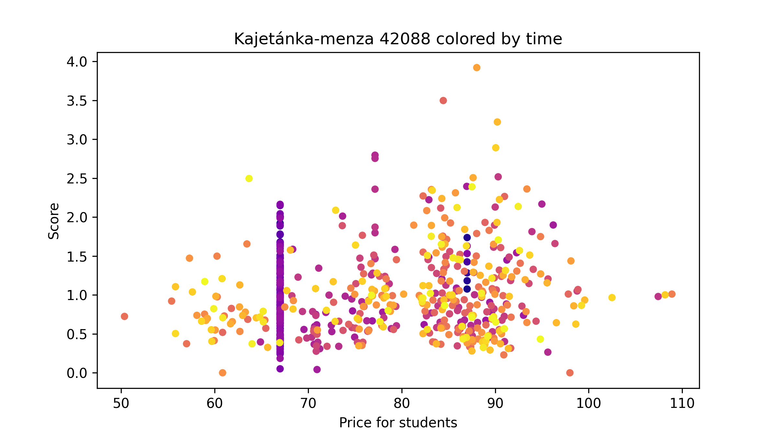
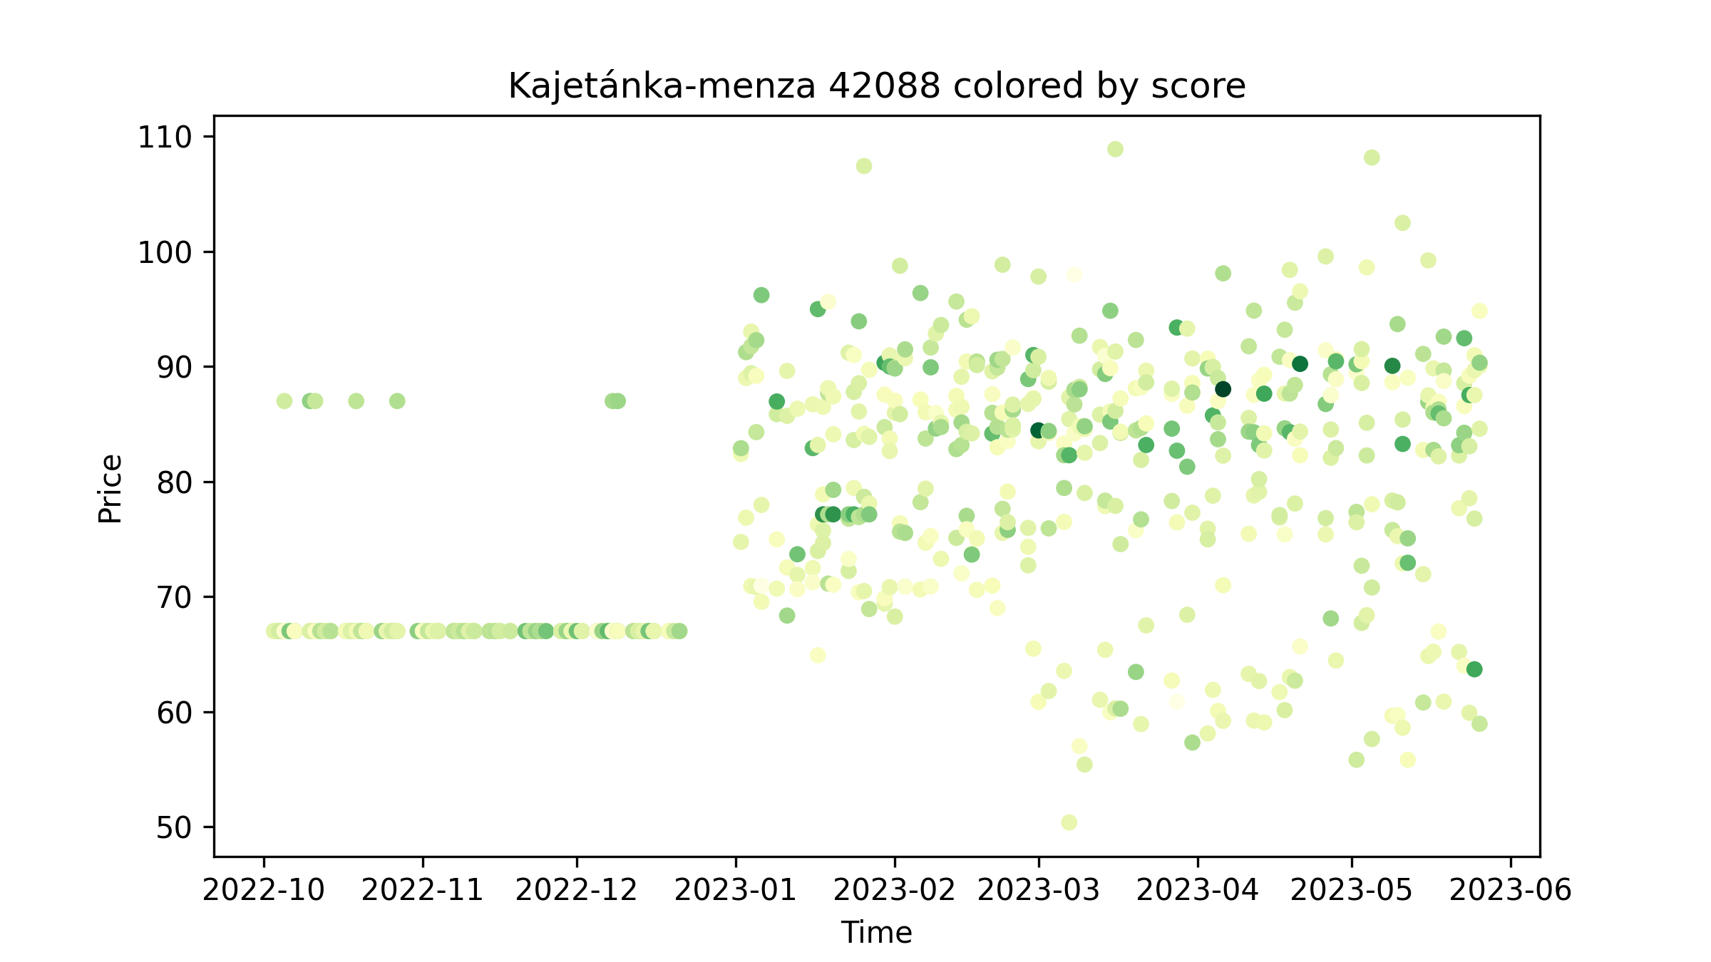
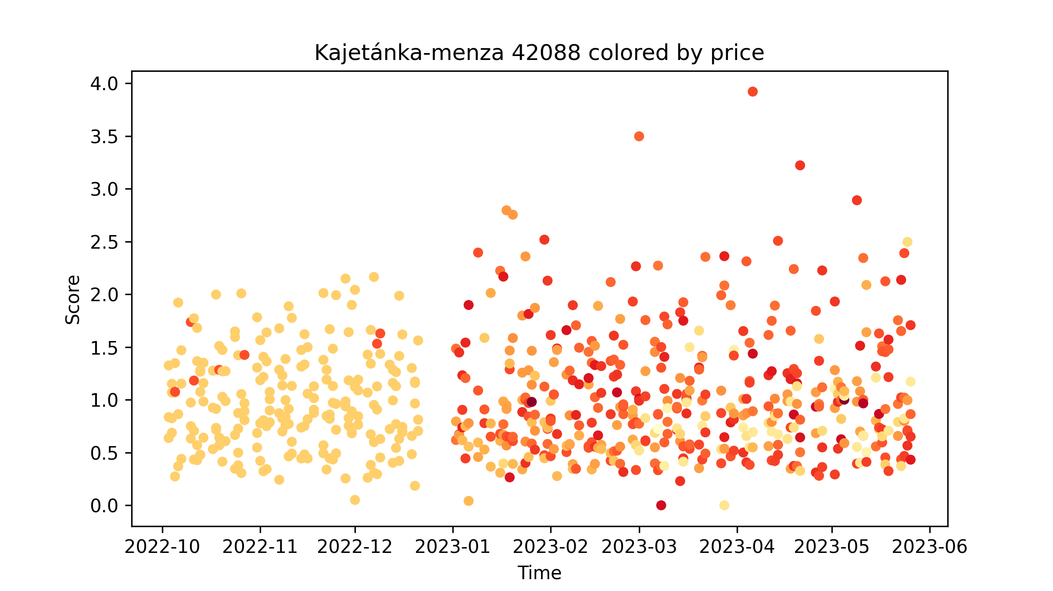

Slide 24
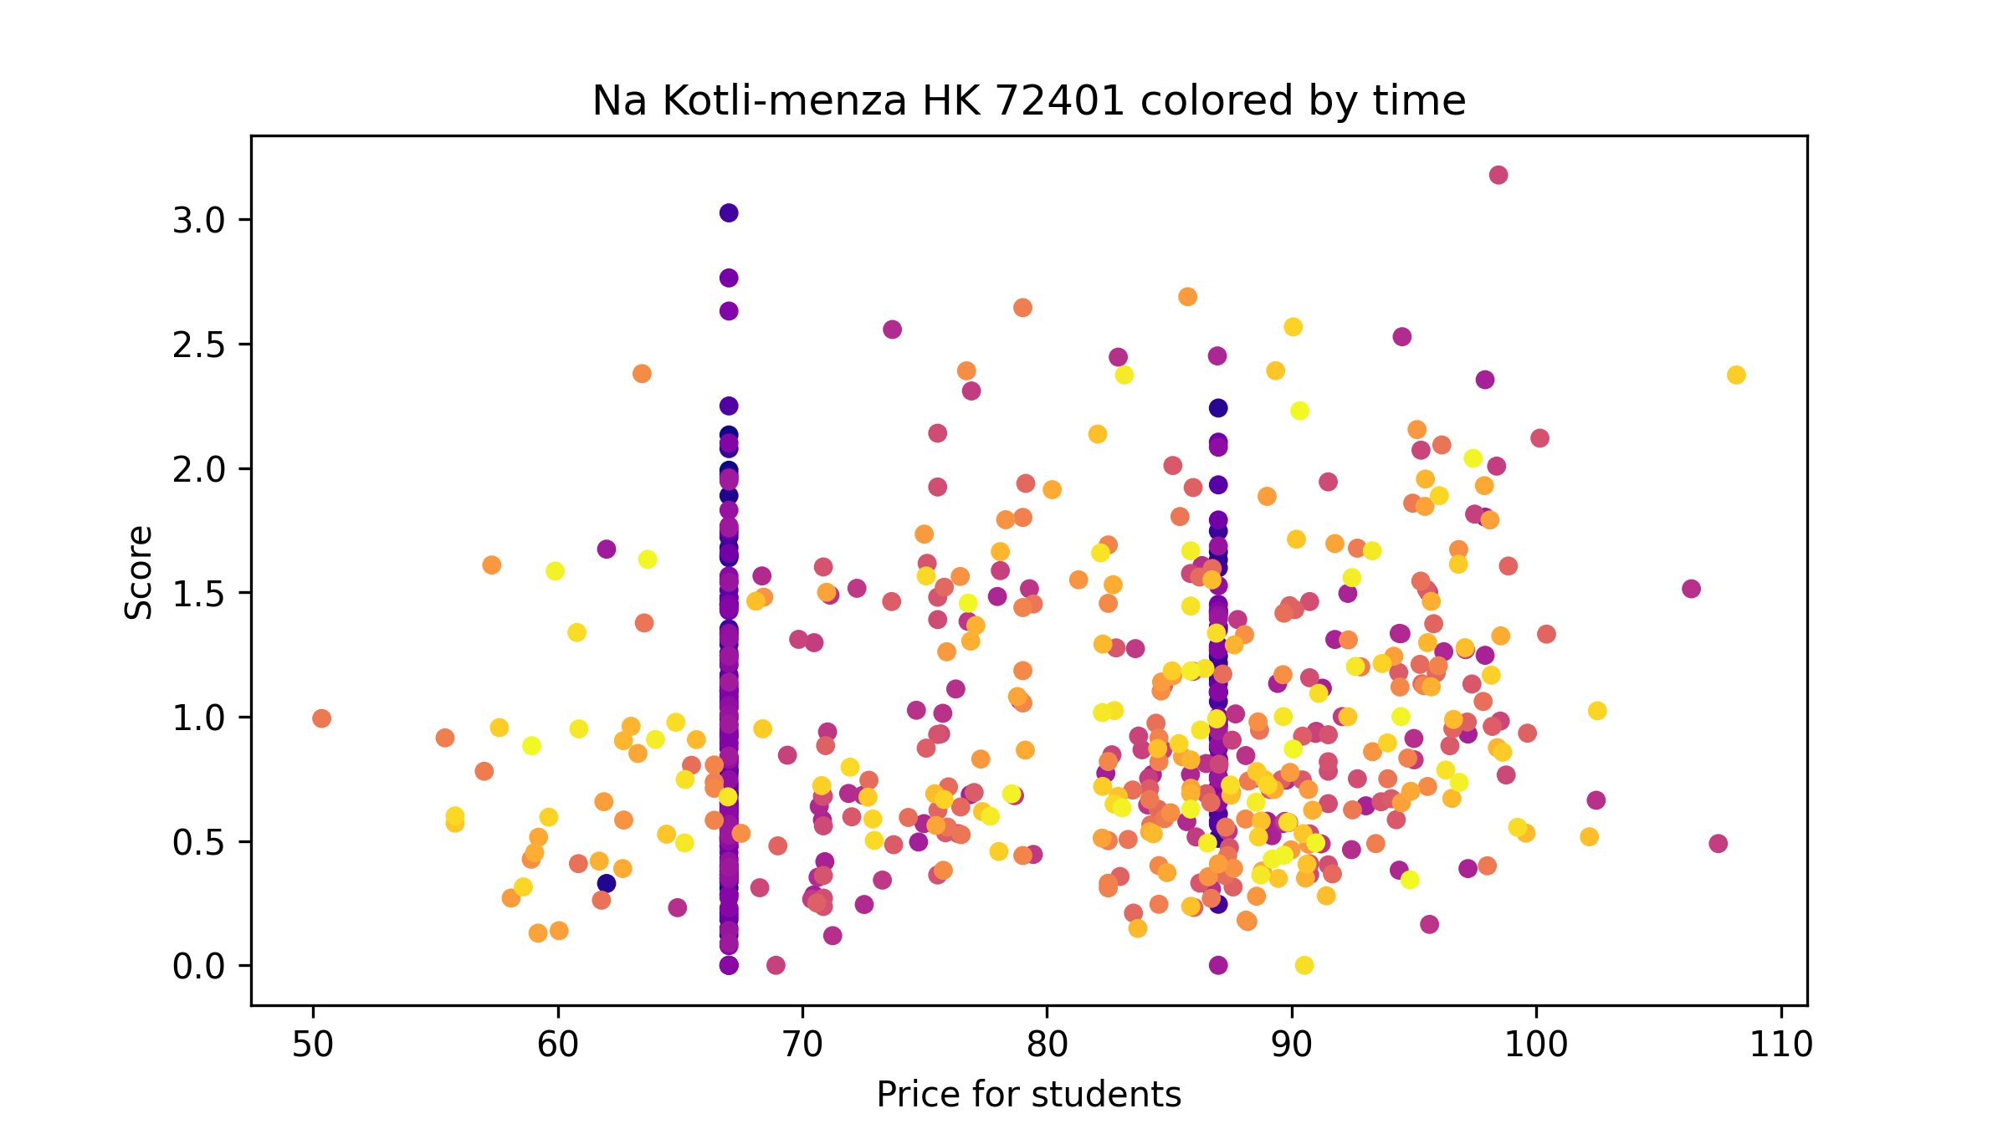
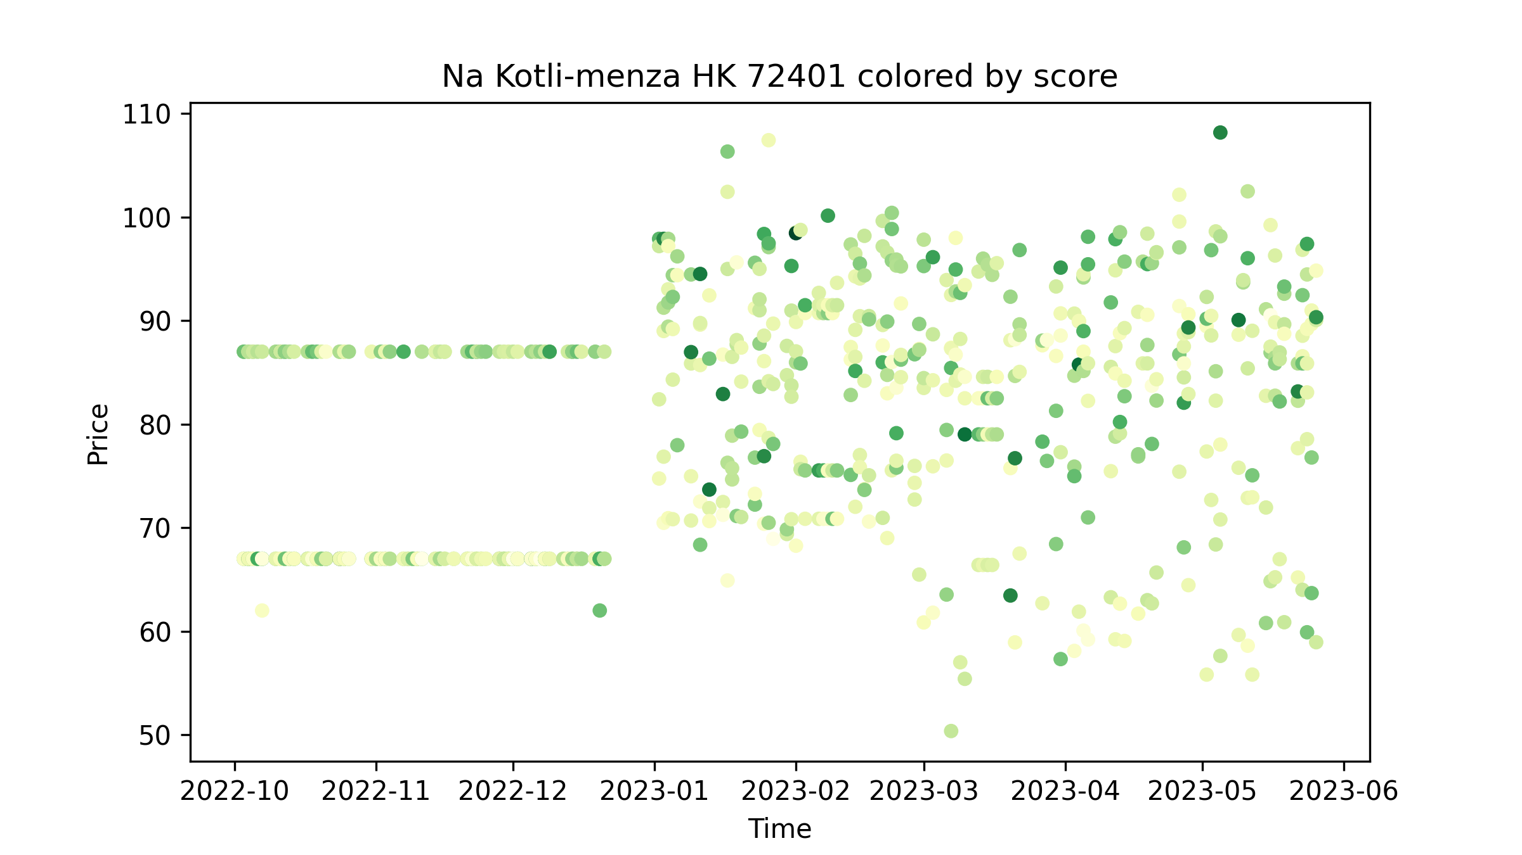
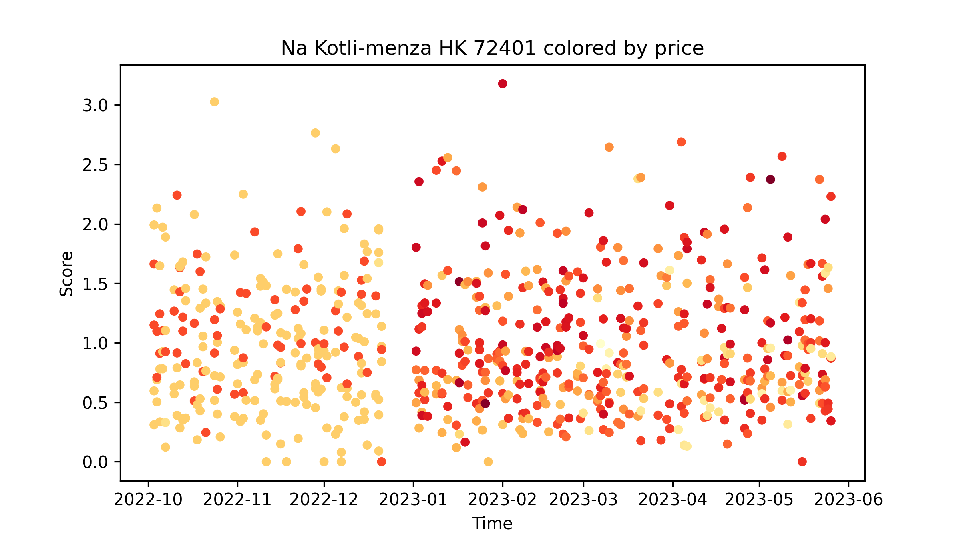

Slide 25




Slide 26




Slide 27




Slide 28
What next?
Grouping by the same meal name
Lot of very similar meal names – typos, synonyms, changes in side dish etc.
Grouping by meal type – type of meat/vegetarian/vegan
Need to gather data through canteen‘s API
Possibly handcraft „sweet meals“, „junk food meals“ categories?
Some analysis over soups?

Slide 29
Thank you for your attention
Questions?

